Slide 1
Introducing New for 2020
OPT Web Services™
Essentials
Account Receivable \ Accounts Payable \ Inventory \ Job Management \ Service & Inspections

Slide 2
OPT Essentials for Accounts Receivables

Slide 3
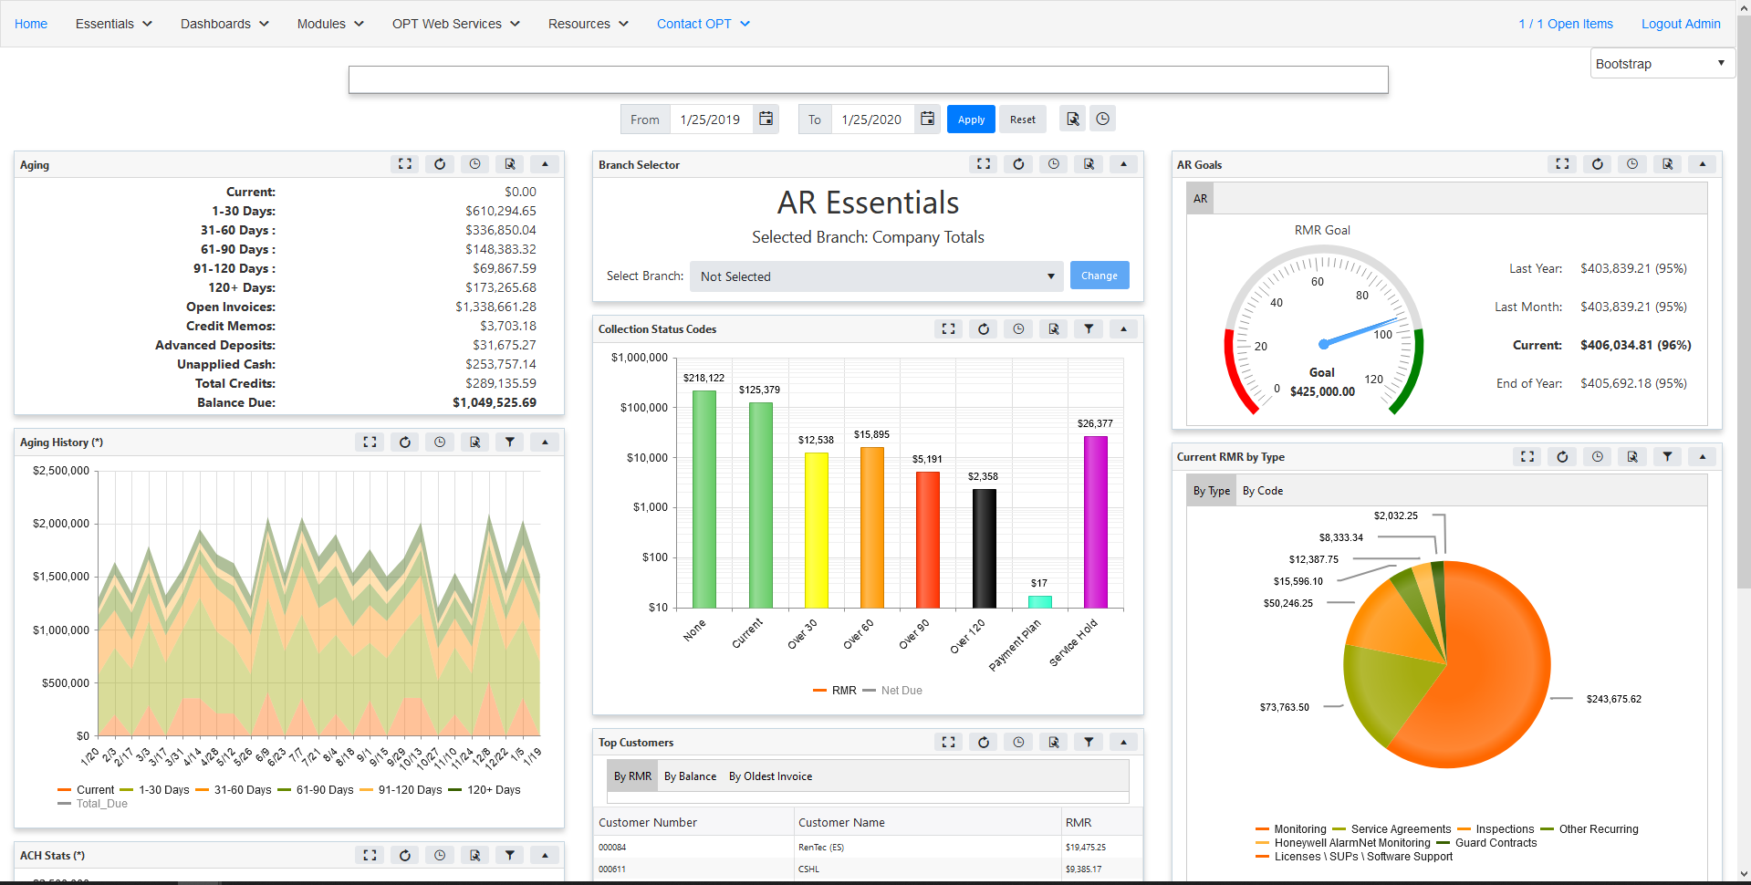
Accounts Receivable

Slide 4
Page Settings

Slide 5
Current Aging and Credits

Slide 6
Aging History

Slide 7
RMR Goals

Slide 8
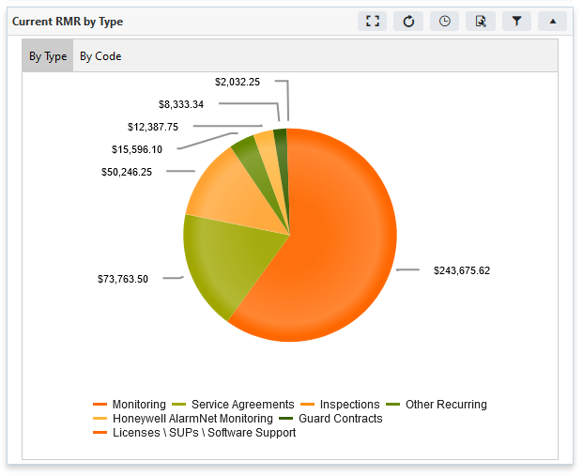
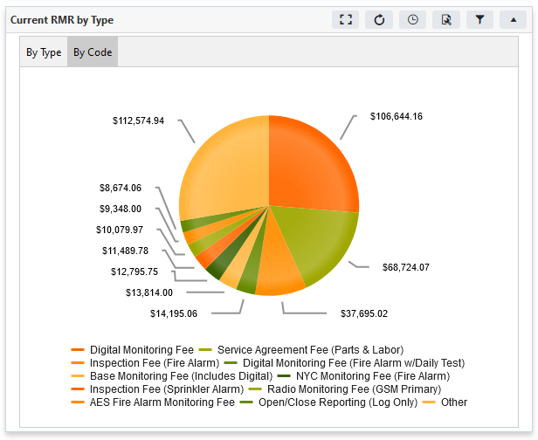
Current RMR by Type/Code

Slide 9
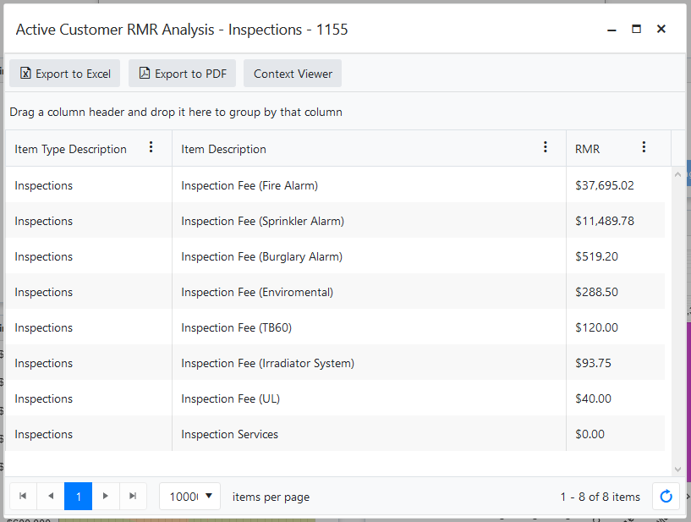
RMR by Type - Details

Slide 10
RMR/Net Due by Collection Status

Slide 11
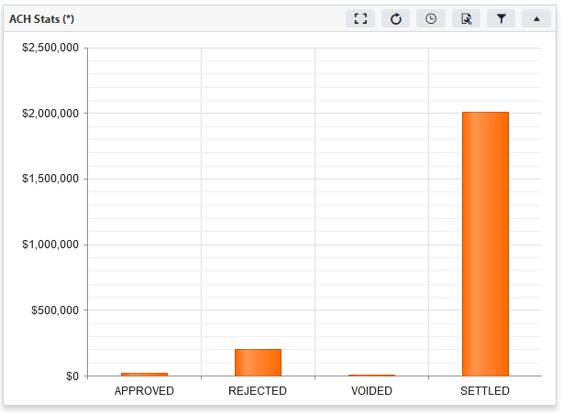
ACH Funding Totals

Slide 12
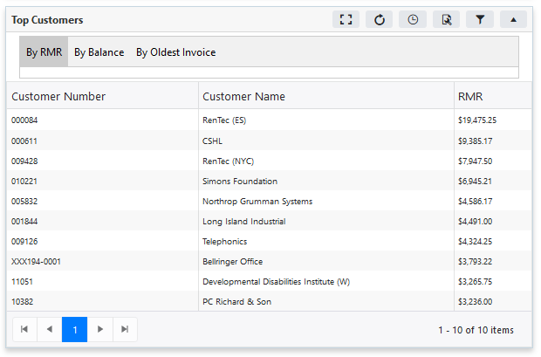
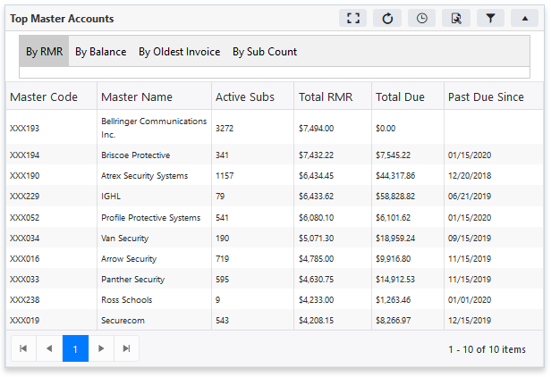
Top Customers / Masters

Slide 13
AR Essentials Coming Soon

Slide 14
OPT Essentials for Accounts Payable

Slide 15
Accounts Payable

Slide 16
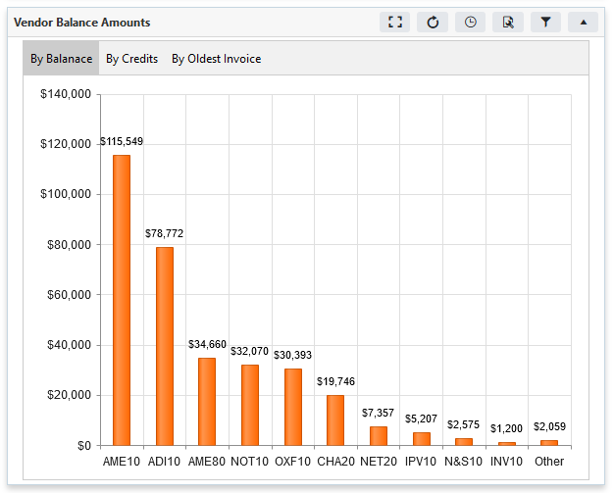
Vendors by Open Balance Amounts

Slide 17
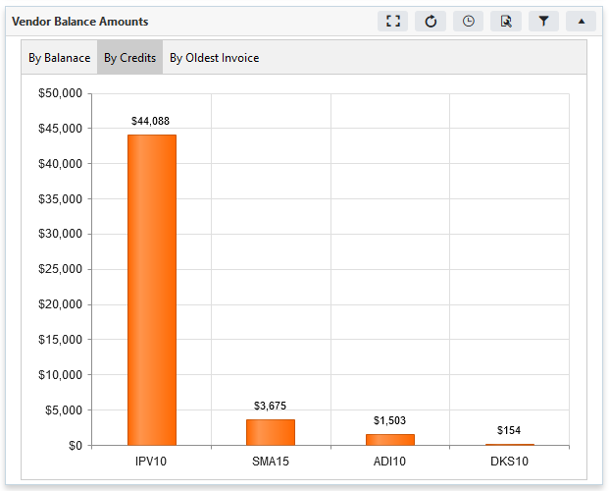
Vendors by Open Credits

Slide 18
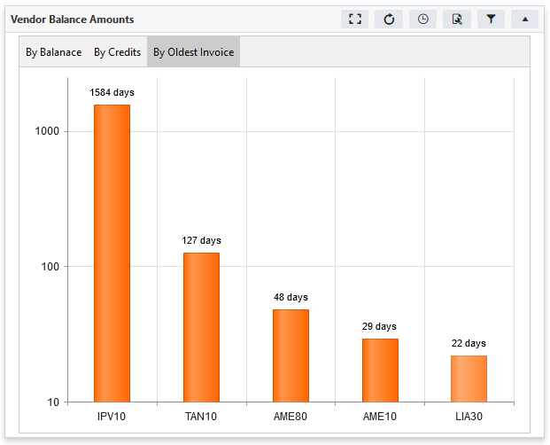
Vendors by Oldest Open Invoice

Slide 19
AP Essentials Coming Soon
AP Billing Goal
Bill Aging
Bill Forecasting
PO Aging
Oldest Open POs
Oldest Open Repair Tickets
Refunds/Returns

Slide 20
OPT Essentials for Inventory

Slide 21
Inventory Essentials Coming Soon
Value of Inventory On Hand By Warehouse
Frequently Used Part Items
Frequently PPV Adjusted Parts

Slide 22
OPT Essentials for Job Manangement

Slide 23
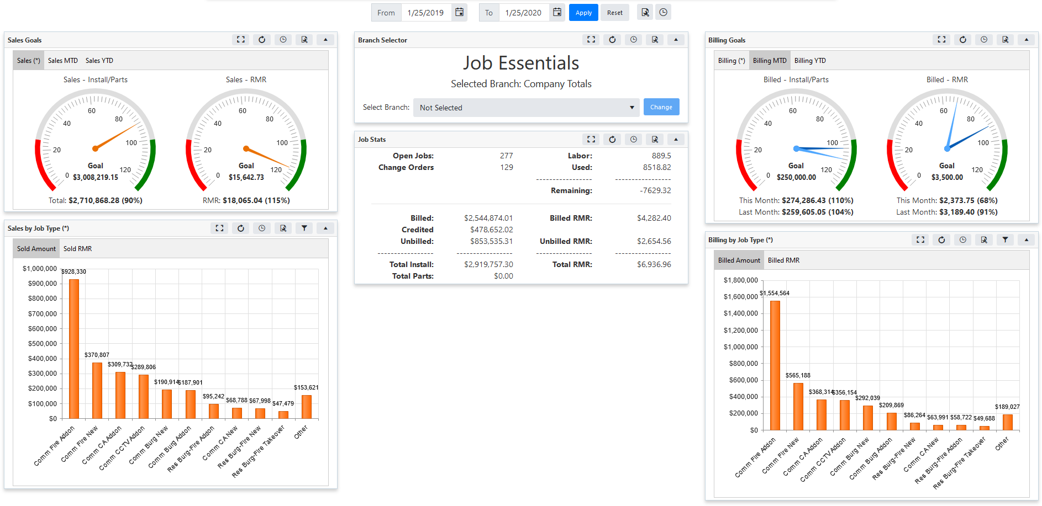
Job Management

Slide 24
Job Stats by Sold Date

Slide 25
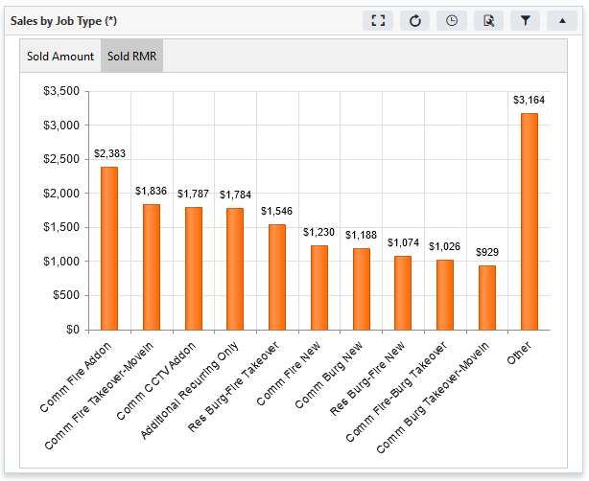
Job Sales Install vs RMR by Job Type

Slide 26
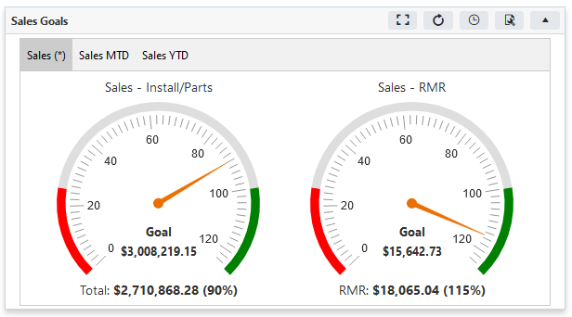
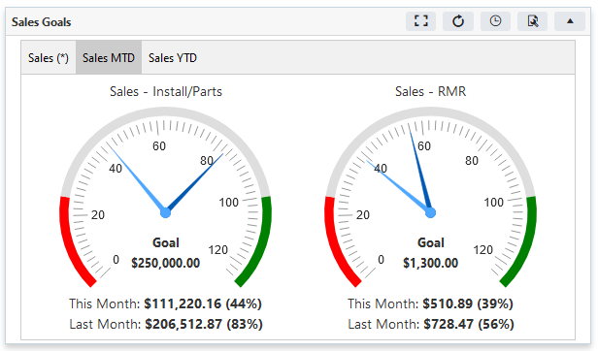
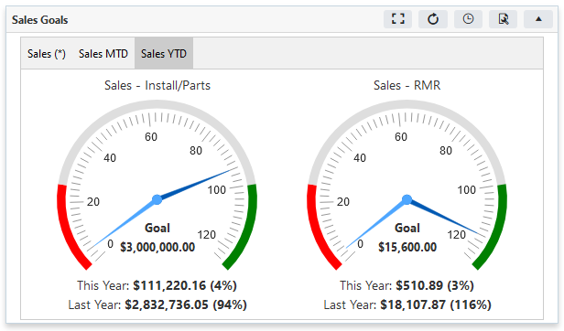
Job Sales Goals

Slide 27
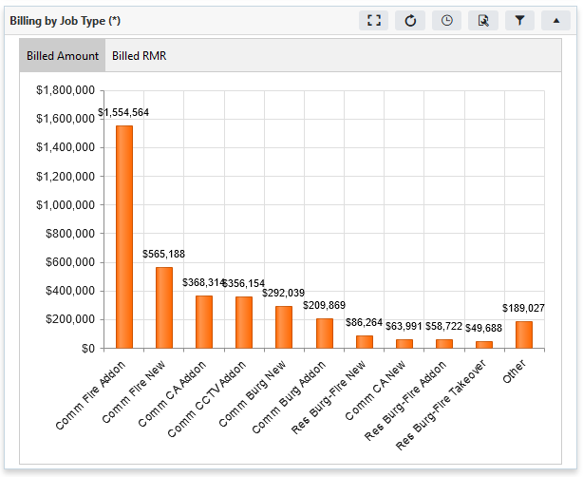
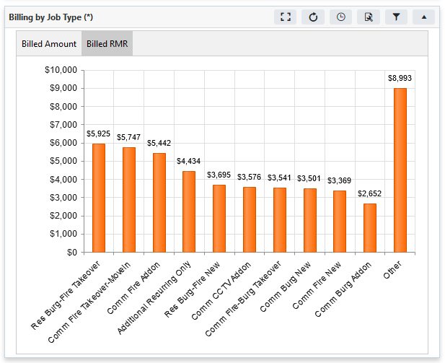
Job Billing Install vs RMR by Job Type

Slide 28
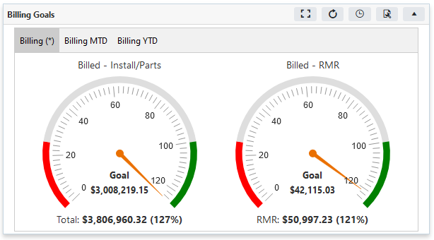
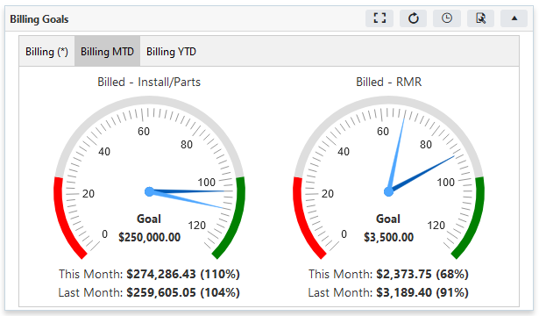
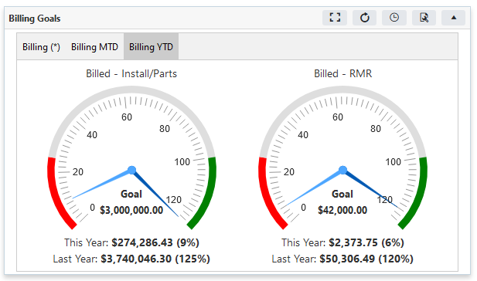
Job Billing Goals

Slide 29
Job Essentials Coming Soon
Job Invoice Aging

Slide 30
OPT Essentials for Service / Inspections

Slide 31
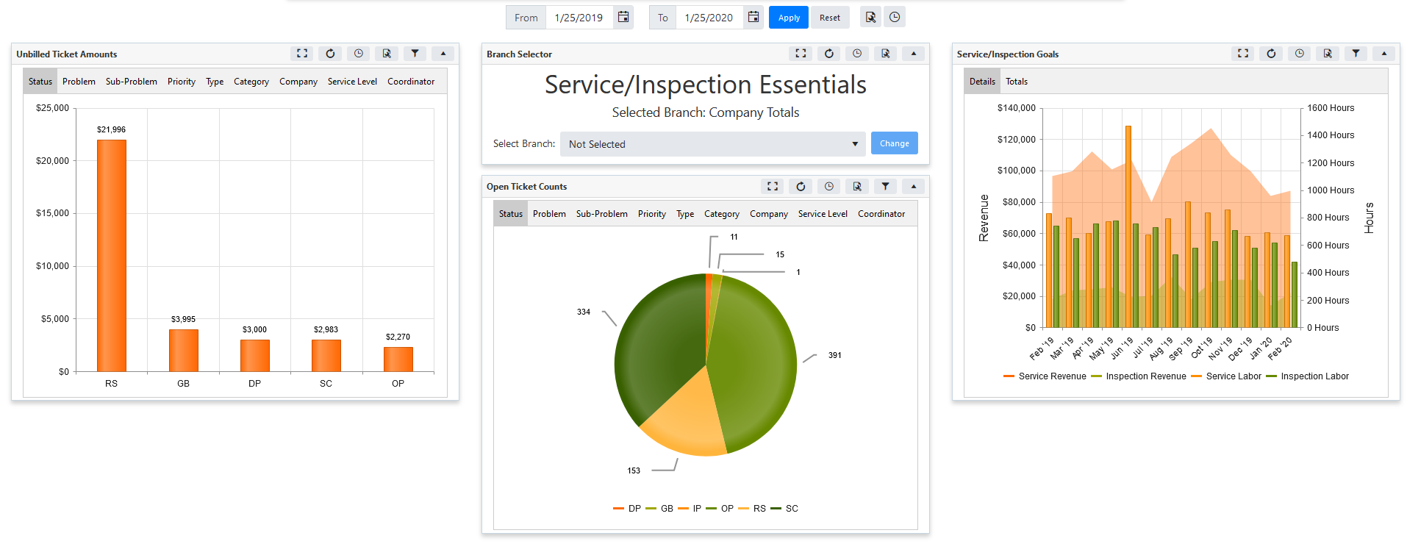
Job Management

Slide 32
Ticket Revenue vs Labor

Slide 33
Total Ticket Revenue vs Labor w/ Goal

Slide 34
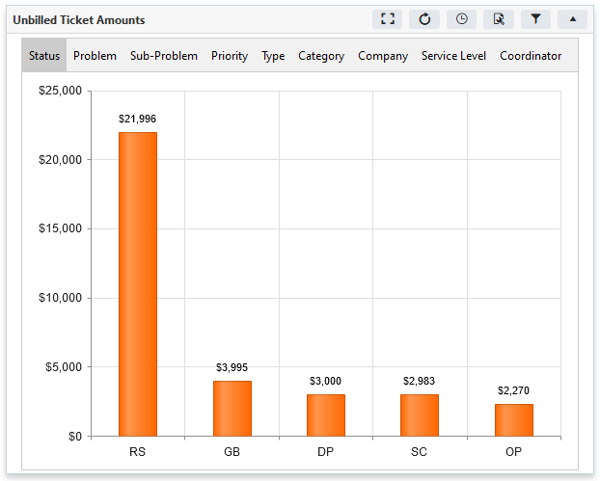
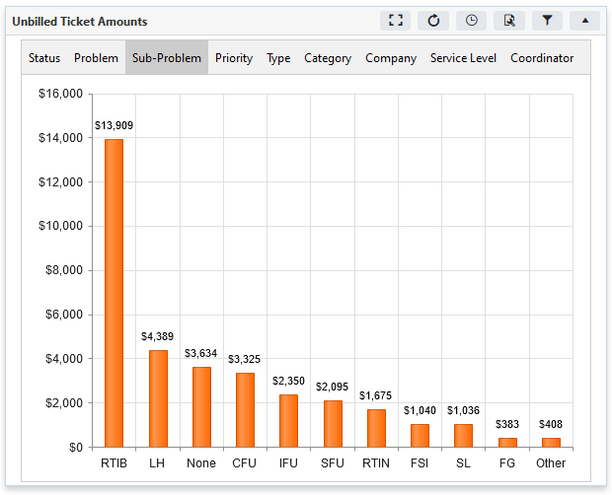
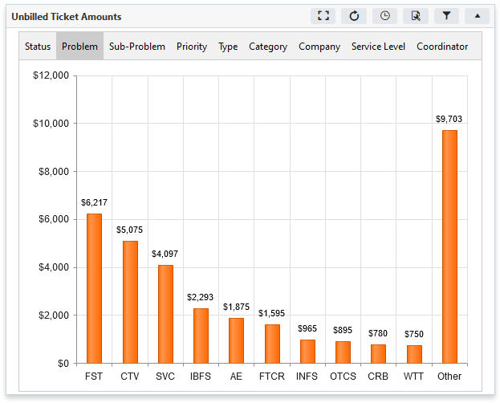
Unbilled Ticket Amounts

Slide 35
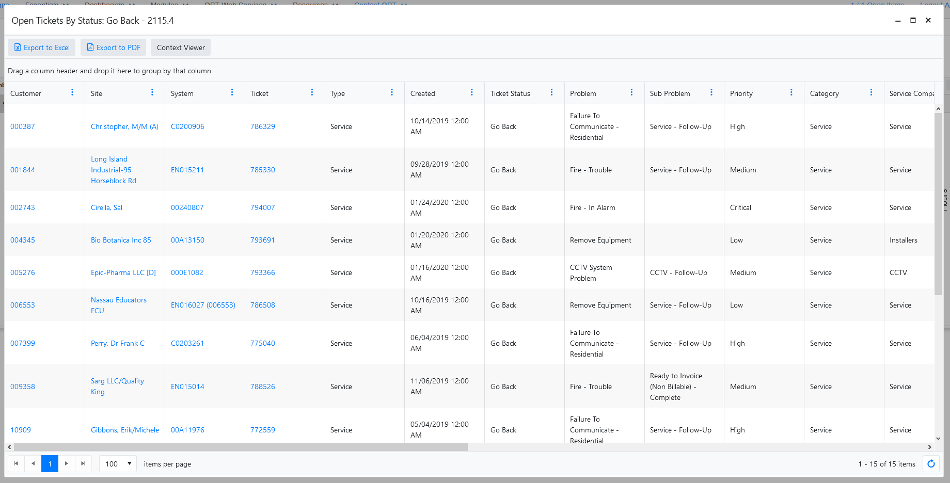
Ticket Drill Down

Slide 36
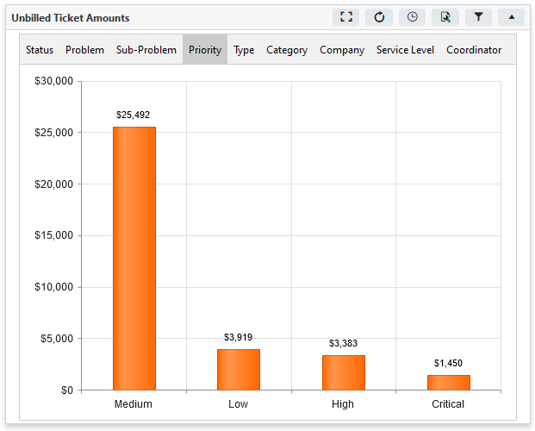
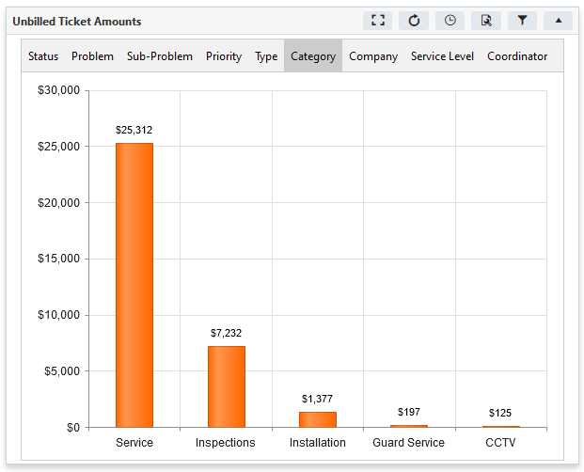
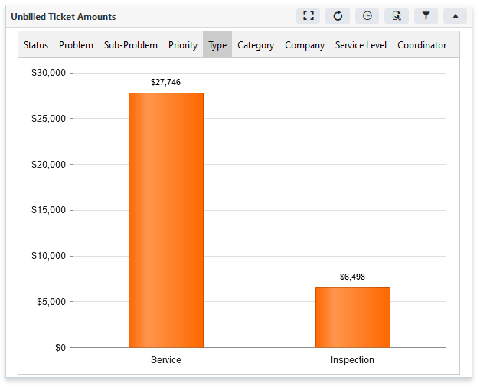
Unbilled Ticket Amounts (cont)

Slide 37
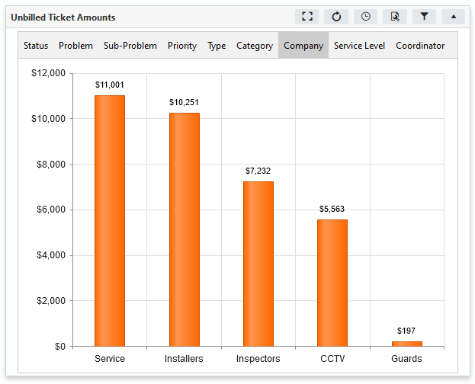
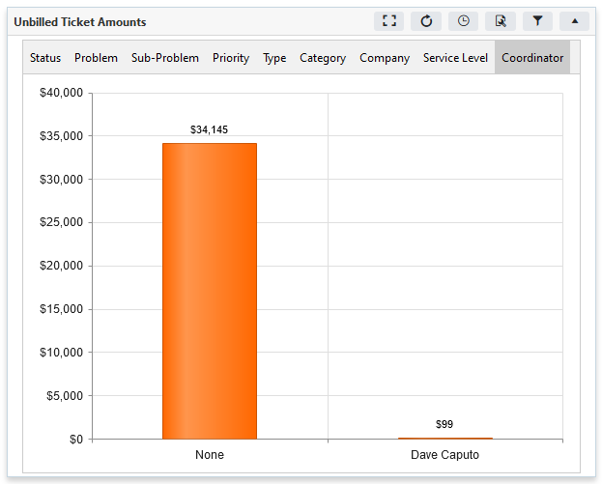
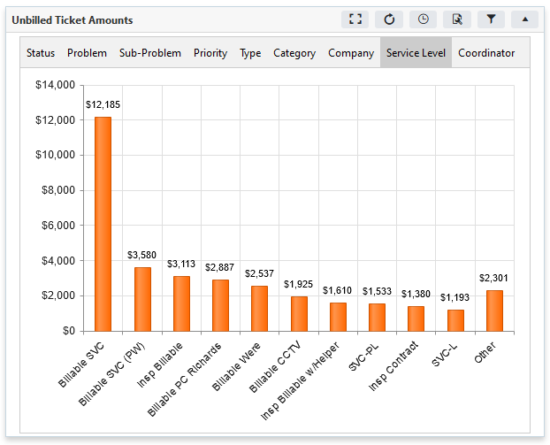
Unbilled Ticket Amounts (cont)

Slide 38
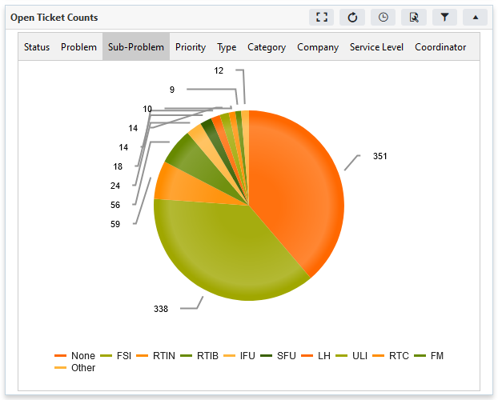
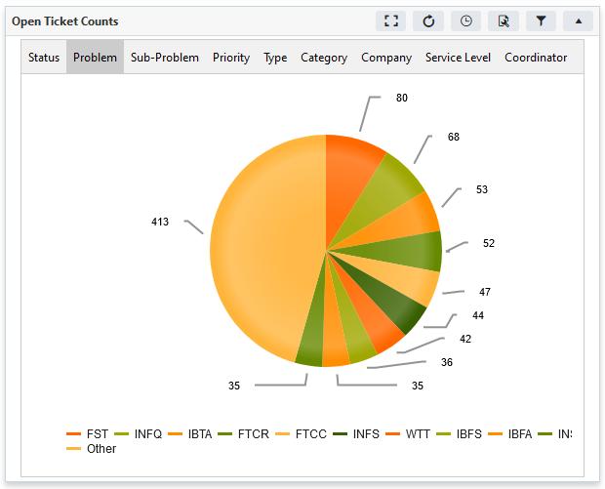
Open Ticket Counts

Slide 39
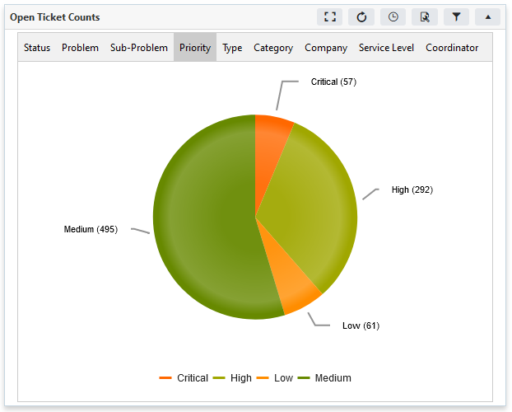
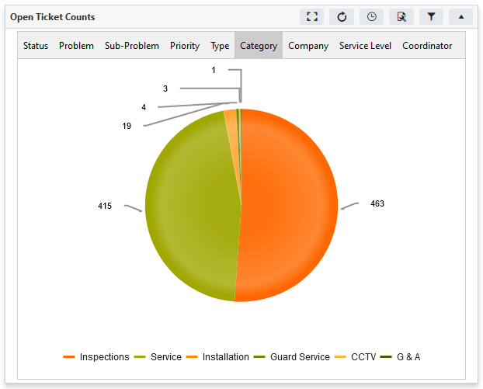
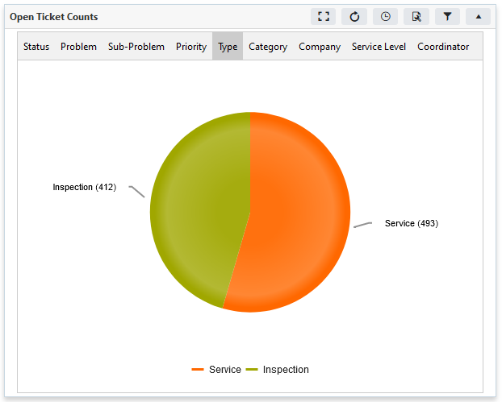
Open Ticket Counts (cont)

Slide 40
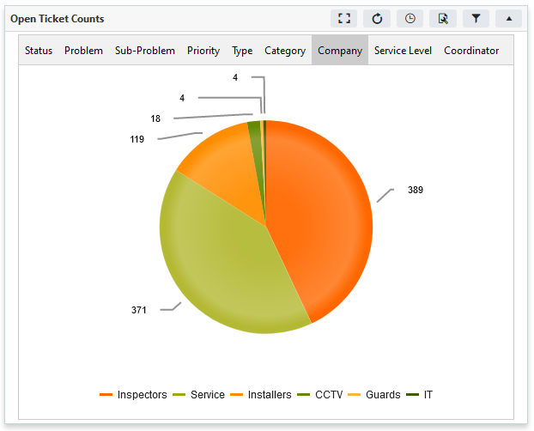
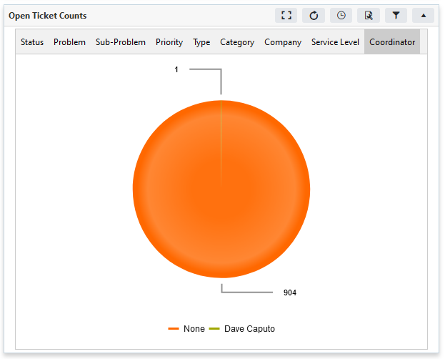
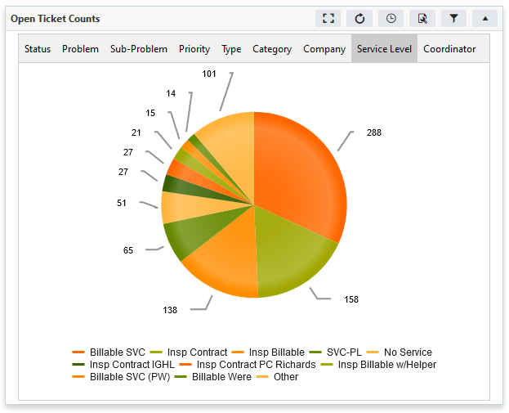
Open Ticket Counts (cont)

Slide 41
Ticket Essentials Coming Soon
Ticket Invoice Aging
Ticket Aging
Inspections By Type

Slide 42
General Requirements
Requires the use of an IIS Web Server
Can be hosted on your SedonaOffice server if it is only to be used internally.
Does not require SedonaSync, Crystal Reports or any Additional Licensing
If accessing the dashboards remotely:
Some additionally network setup may be necessary such as DNS settings, Port Forwarding and we recommend the use of an SSL certificate.
The application should be hosted on the SedonaWeb or another isolated server.

Slide 43
And the Best Part… For SOUC 2020’s Show Special No Installation Fees, No License Fees, Unlimited Users
Its Free, well almost…
There is a small monthly maintenance fee of ($79.95) per database billed annually.
This fee will allow us to keep your system up to date with the latest dashboards as we roll them out.

Slide 44
Questions & Feedback

