Slide 1
OPT Web Services Modules
OPT Web Services Modules:
Services Reconciliation Module (SRM)
Task Management Module (TMM)
Customers At Risk Module (CAR)
Customer Insights Module (CIM)
Extended Data Module (EDM)
Key Account Package (KAP)
Avalara Tax Module (ATM)
Profit & Loss Module (PL)
Document Handler (DH)
Timeline Module (TM)
Survey Module (SM)
Essentials (ESM)
Scheduler (SCH)
OPT SedonaSync Modules:
Complete Operations Reporting
Automated Email Collections
Automated Email Invoicing
Salesperson Notifications
Appointment Reminders
Dispatch Notifications
Inventory Monitoring
Financial Overviews
Sales Reporting
Presented By:
OPT Business Services
OPT Business Services, Inc.

Slide 2
Custom User Workflows
Realtime Web Dashboards
Link Company Resources Pages
On Demand Crystal Reports
Customer Profit & Loss Module
Open SedonaOffice Item from OPTWS
Via OPTWS App
Full User/Group Level Security
with Single Sign On
Open OPTWS Item from SedonaOffice
Via OPT Buttons
SedonaOffice
Database ODBC
Avalara Tax Integration
SedonaSync
Database ODBC
Services Reconciliation Module
OPT Web Services
IIS Web Application
Manitou
Database ODBC
Job Staging Module
Any Other ODBC Database
Customers At Risk Module
Extends SedonaSync Functionality and allows for OPT Web Services Notifications
Formstack API Integration
Customer Task Management
OPT
Essentials
Key Account Package
Image & File Hosted Storage
NPS Survey Module
Live Invoice Download
OPTWS Notifications
Email Report Drilldown
OPT Timeline Module
Email Tracking When Viewed

Slide 3
OPT Timeline Module
OPT Web Services Modules:
Services Reconciliation Module (SRM)
Task Management Module (TMM)
Customers At Risk Module (CAR)
Customer Insights Module (CIM)
Extended Data Module (EDM)
Key Account Package (KAP)
Avalara Tax Module (ATM)
Profit & Loss Module (PL)
Document Handler (DH)
Timeline Module (TM)
Survey Module (SM)
Essentials (ESM)
Scheduler (SCH)
OPT SedonaSync Modules:
Complete Operations Reporting
Automated Email Collections
Automated Email Invoicing
Salesperson Notifications
Appointment Reminders
Dispatch Notifications
Inventory Monitoring
Financial Overviews
Sales Reporting
Presented By:
OPT Business Services
OPT Business Services, Inc.

Slide 4
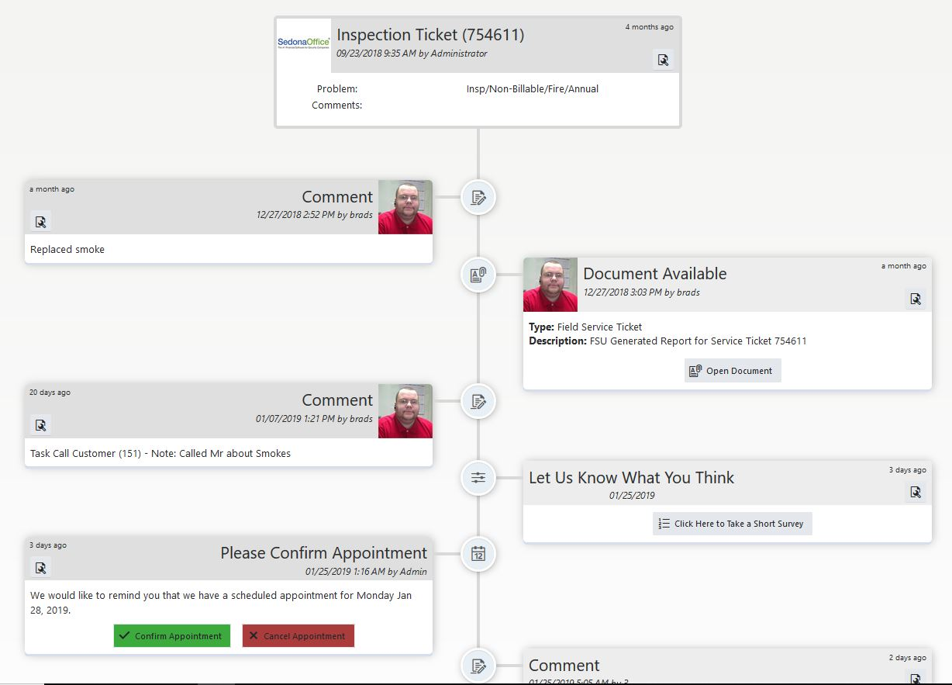
Timeline Preview

Slide 5
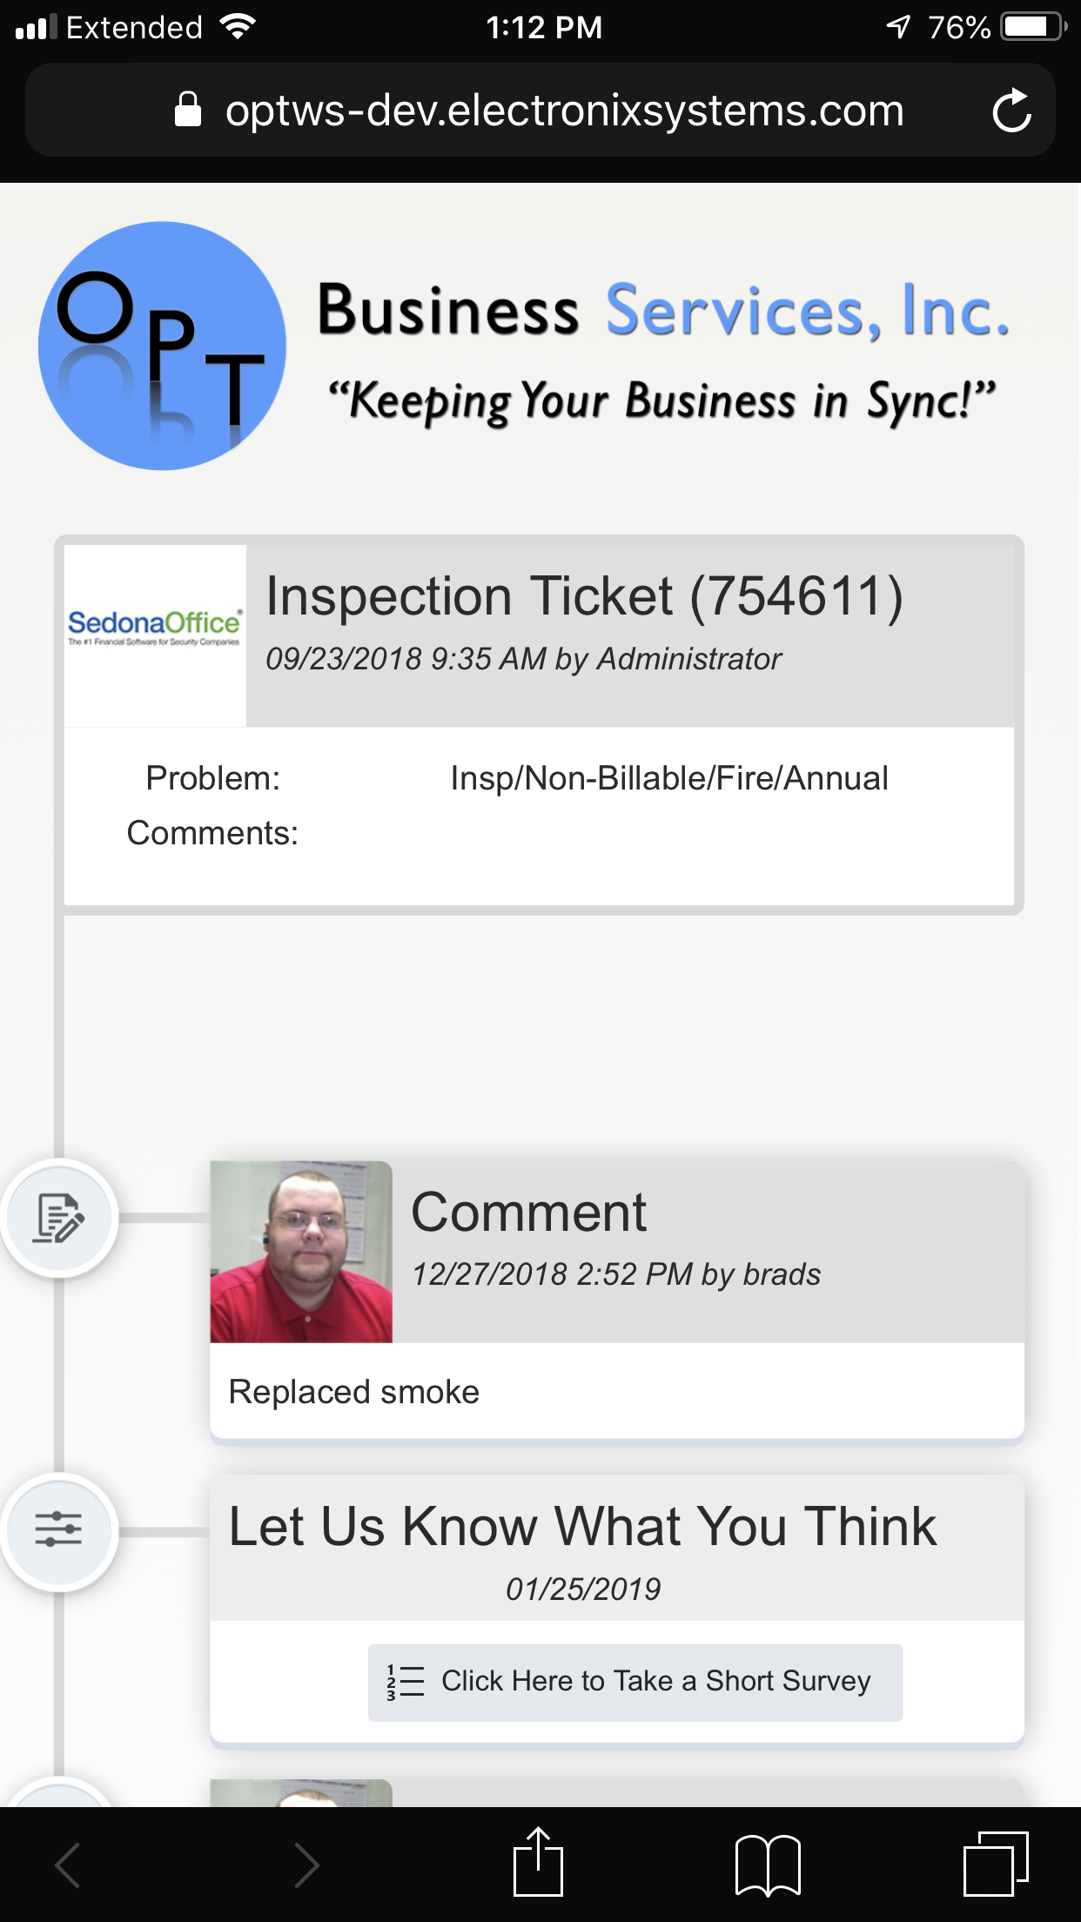
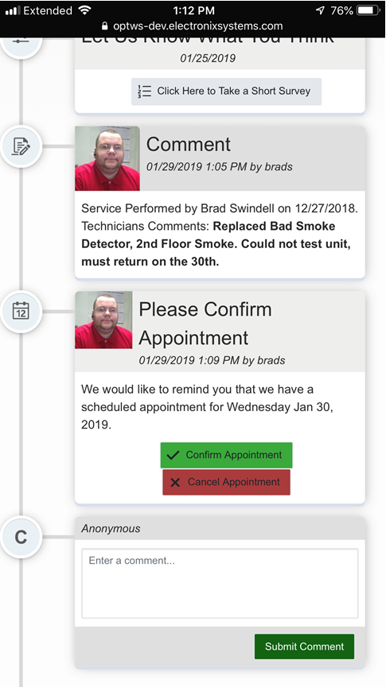
Timeline Items
Job / Ticket Created
Service Coordinator / Project Manager Details
Appointment Created
Appointment Scheduled
Confirm / Cancel Buttons
Job / Ticket Notes
Documents / Photos
Survey Request
Invoice
Pay Now via SedonaWeb
Add Comment
Custom Modules Available

Slide 6
OPT Document Handler (DH)
OPT Web Services Modules:
Services Reconciliation Module (SRM)
Task Management Module (TMM)
Customers At Risk Module (CAR)
Customer Insights Module (CIM)
Extended Data Module (EDM)
Key Account Package (KAP)
Avalara Tax Module (ATM)
Profit & Loss Module (PL)
Document Handler (DH)
Timeline Module (TM)
Survey Module (SM)
Essentials (ESM)
Scheduler (SCH)
OPT SedonaSync Modules:
Complete Operations Reporting
Automated Email Collections
Automated Email Invoicing
Salesperson Notifications
Appointment Reminders
Dispatch Notifications
Inventory Monitoring
Financial Overviews
Sales Reporting
Presented By:
OPT Business Services
OPT Business Services, Inc.

Slide 7
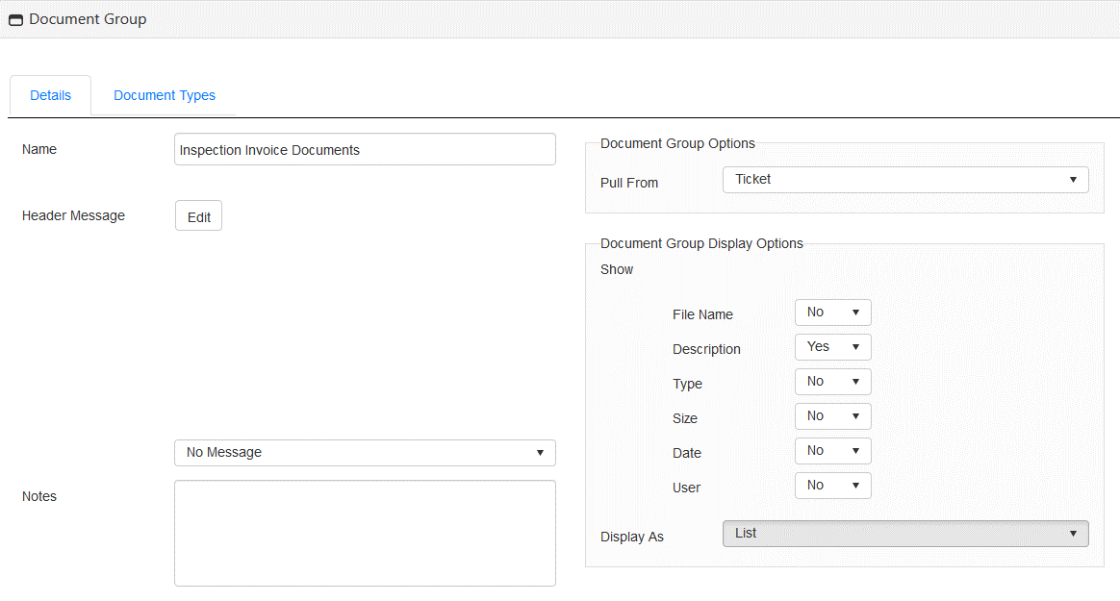
Document Group Settings

Slide 8
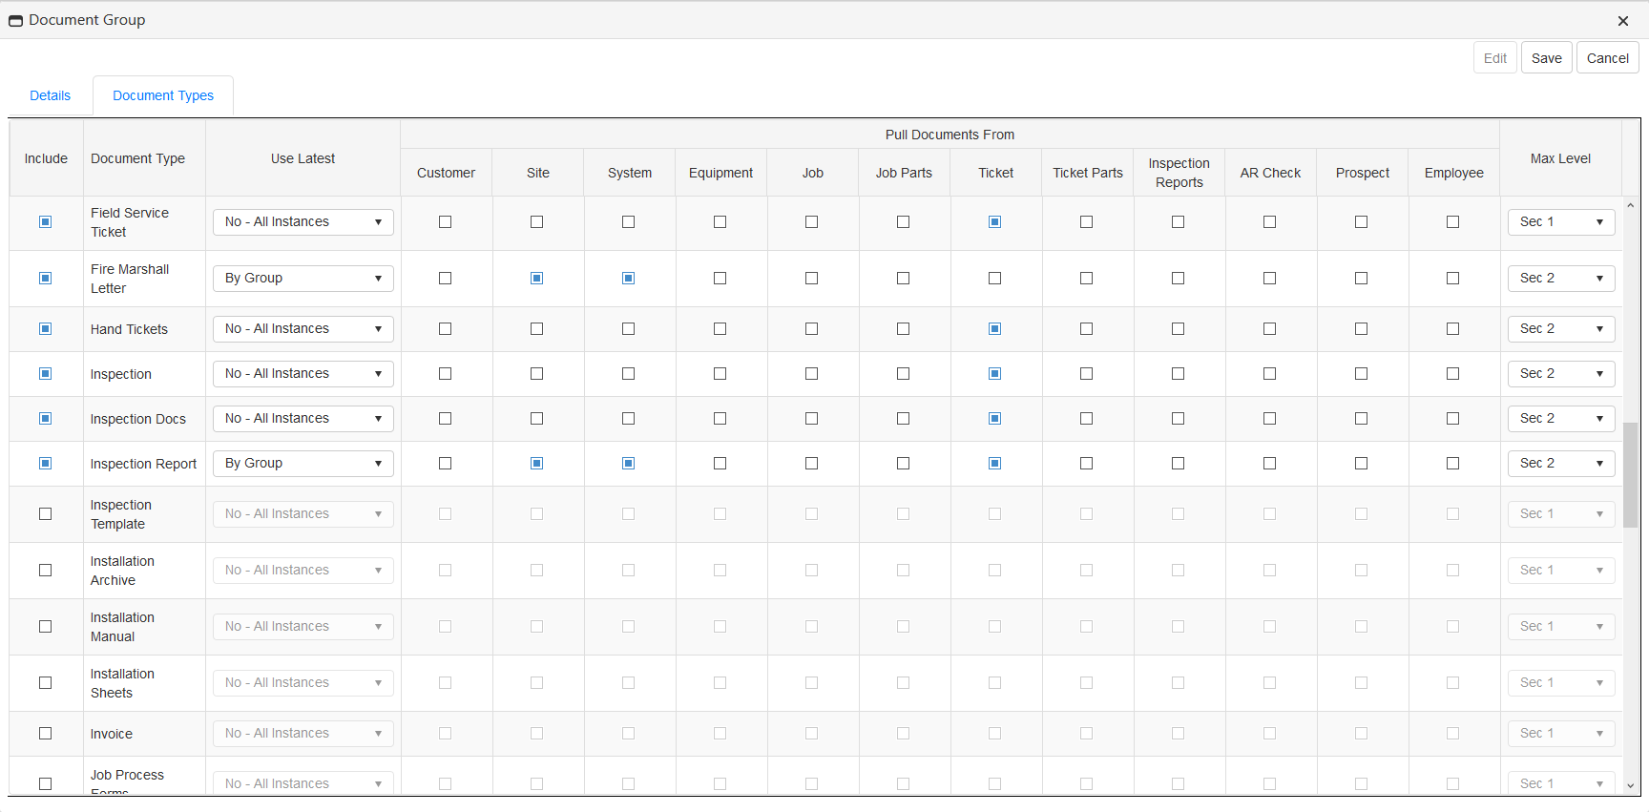
Select Document Types

Slide 9
OPT Survey Module (SM)
OPT Web Services Modules:
Services Reconciliation Module (SRM)
Task Management Module (TMM)
Customers At Risk Module (CAR)
Customer Insights Module (CIM)
Extended Data Module (EDM)
Key Account Package (KAP)
Avalara Tax Module (ATM)
Profit & Loss Module (PL)
Document Handler (DH)
Timeline Module (TM)
Survey Module (SM)
Essentials (ESM)
Scheduler (SCH)
OPT SedonaSync Modules:
Complete Operations Reporting
Automated Email Collections
Automated Email Invoicing
Salesperson Notifications
Appointment Reminders
Dispatch Notifications
Inventory Monitoring
Financial Overviews
Sales Reporting
Presented By:
OPT Business Services
OPT Business Services, Inc.

Slide 10
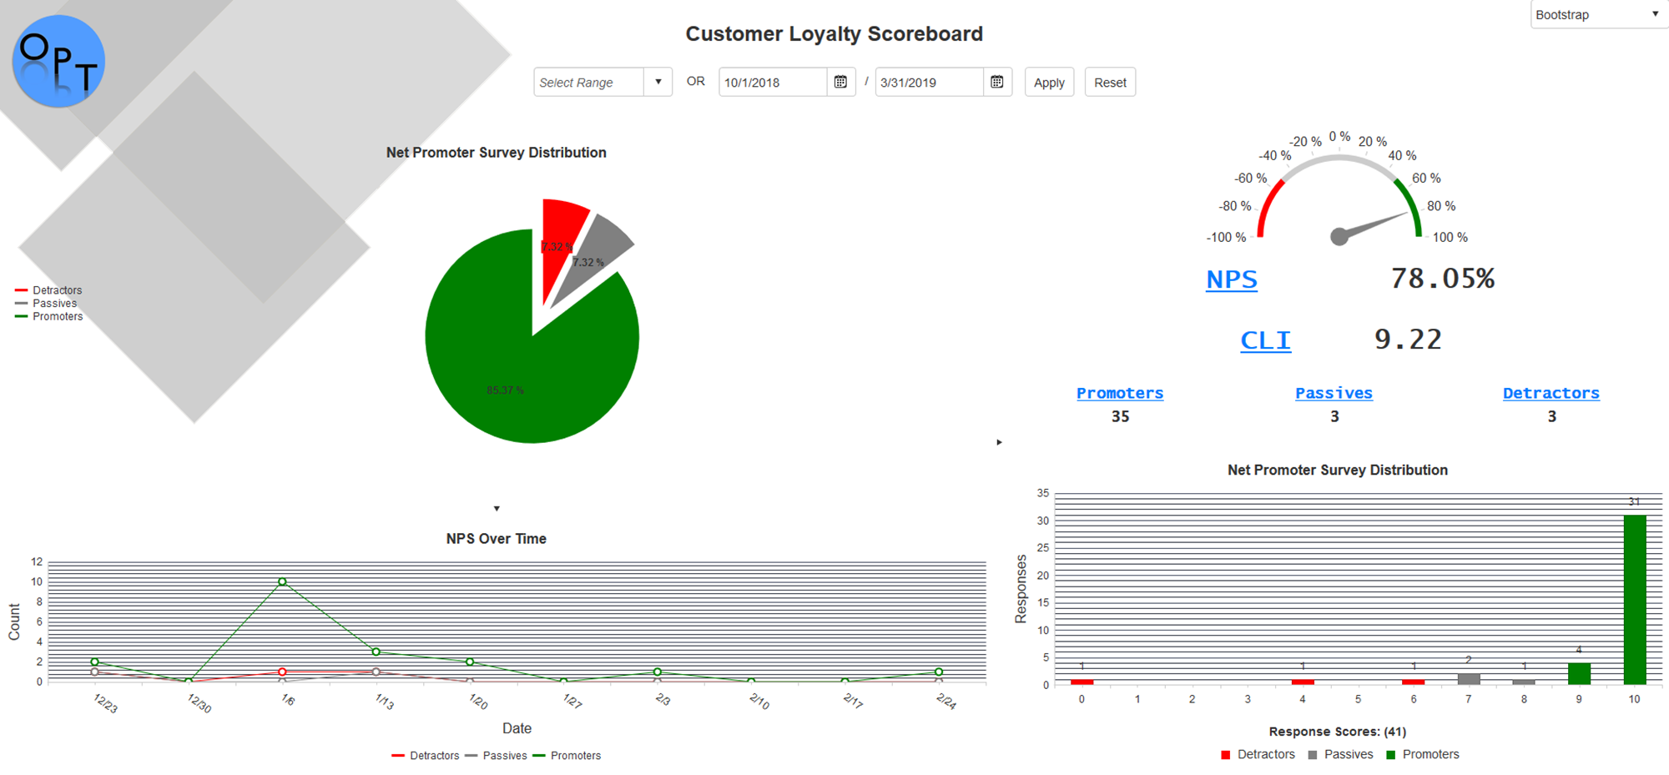
Company Dashboard

Slide 11
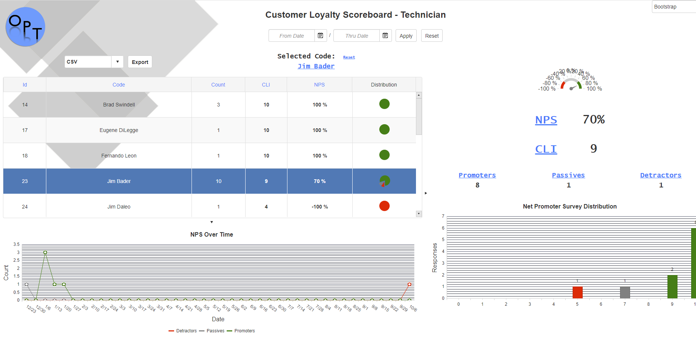
Survey Results by Tech

Slide 12
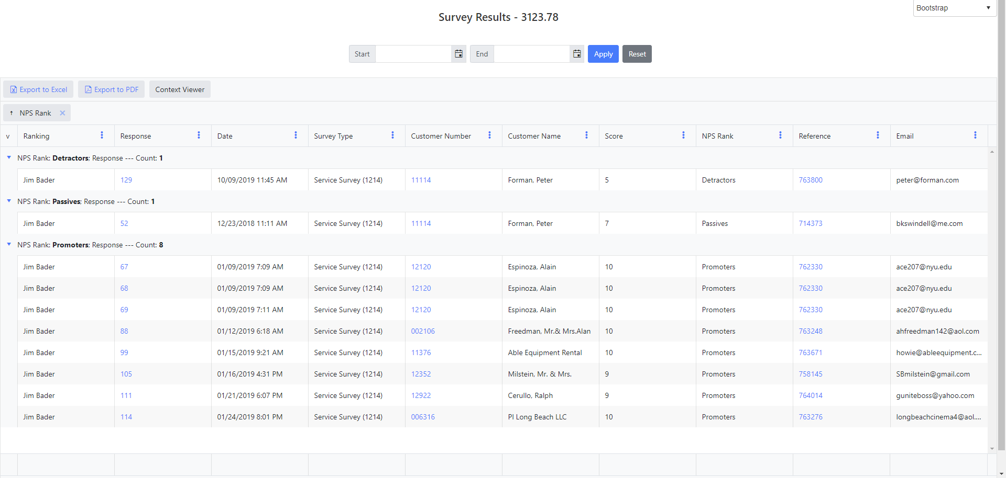
Survey Details

Slide 13
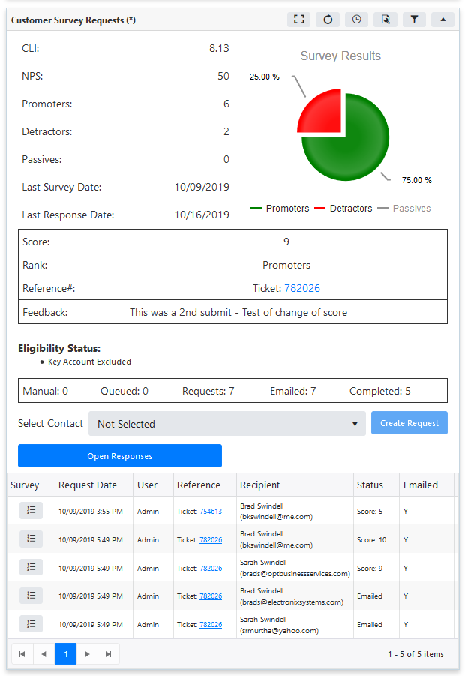
Customer Survey Analysis

Slide 14
OPT Services Reconciliation Module (SRM)
OPT Web Services Modules:
Services Reconciliation Module (SRM)
Task Management Module (TMM)
Customers At Risk Module (CAR)
Customer Insights Module (CIM)
Extended Data Module (EDM)
Key Account Package (KAP)
Avalara Tax Module (ATM)
Profit & Loss Module (PL)
Document Handler (DH)
Timeline Module (TM)
Survey Module (SM)
Essentials (ESM)
Scheduler (SCH)
OPT SedonaSync Modules:
Complete Operations Reporting
Automated Email Collections
Automated Email Invoicing
Salesperson Notifications
Appointment Reminders
Dispatch Notifications
Inventory Monitoring
Financial Overviews
Sales Reporting
Presented By:
OPT Business Services
OPT Business Services, Inc.

Slide 15
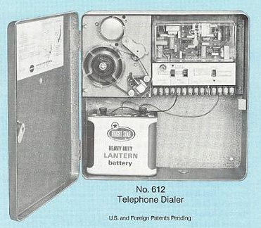
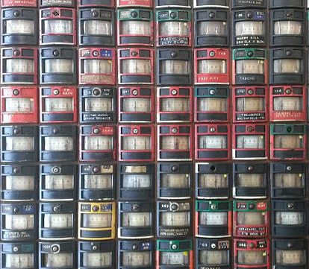
How many of us are installing this piece of cutting edge technology?
Gone are the days where a simple digital dialer is all you needed to worry about.
The alarm system is far from what it was in those days. 2G, 3G, 4G… CDM… now what?
Not only is it hard to keep up, we are constantly changing equipment and services.

Slide 16
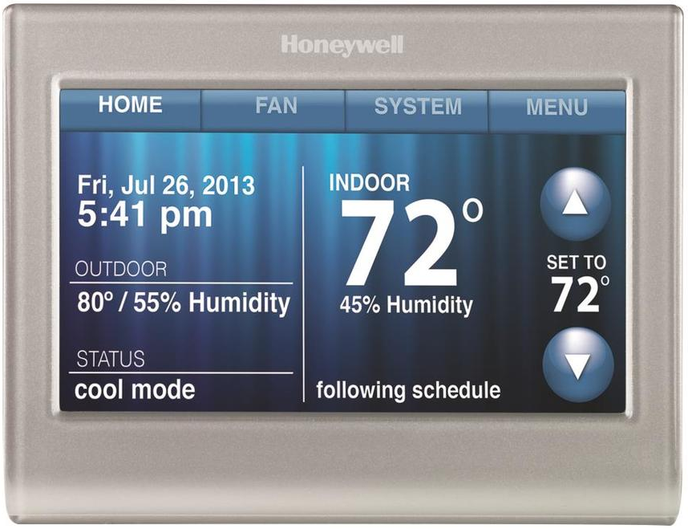
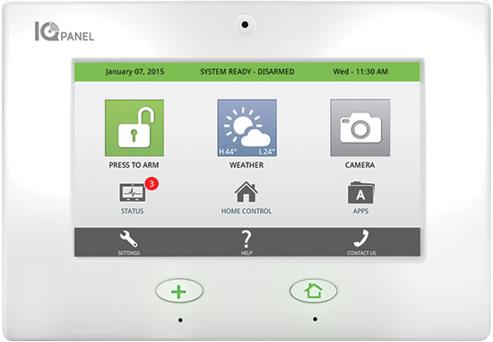
OPT Services Reconciliation Module (SRM)
In addition we are now offering different services from several vendors.
How often do you check with each vendor to make sure your bills are accurate?
Are your customers billed correctly?

Slide 17
OPT Services Reconciliation Module (SRM)
OPT has the solution to quickly and accurately compare each of your third-party vendor bills (such as; AlarmNet, SecureCom and Alarm.com) or your central station data with your accounts in SedonaOffice!
We have expanded our Service Reconciliation Module (SRM) to ensure not only your accounts have been loaded appropriately but the associated customer recurring is profitable. With SRM you can accurately identify issues and perform your reconciliations faster and easier than ever before.
OPTBizSvc.com/SOUC-Timeline
Notes:
OPT Services Reconciliation Module (SRM)
Upload your 3rd Party electronic invoices to OPT Web Services for reconciliation of the invoice to your accounts in SedonaOffice.
Map out the data to match the alarm account or secondary alarm account information in SedonaOffice to the related information in the invoice.
Exception dashboards allow you to see unresolved accounts and link possible matches from the dashboard instantly.
Unreconciled items remain in the exception list until resolved manually.
Create a Task in the OPT Customer Task Management Module (CTM) directly from a possible exception match in the dashboard, and assign it to the person who needs to investigate the account further until it is successfully resolved.

Slide 18
OPT Services Reconciliation Module (SRM)
Every month, upload each vendor’s bill to SRM and it will find the systems in SedonaOffice that match each account in the vendor’s bill. You are then presented with list of exceptions that you can then resolve.
OPT will then keep track of the charges from the bill and store it along with the system for access at a later date.
All previously reconciled bill information can be viewed quickly from SedonaOffice via OPT Web Services.
OPTBizSvc.com/SOUC-Timeline
Notes:
OPT Services Reconciliation Module (SRM)
Upload your 3rd Party electronic invoices to OPT Web Services for reconciliation of the invoice to your accounts in SedonaOffice.
Map out the data to match the alarm account or secondary alarm account information in SedonaOffice to the related information in the invoice.
Exception dashboards allow you to see unresolved accounts and link possible matches from the dashboard instantly.
Unreconciled items remain in the exception list until resolved manually.
Create a Task in the OPT Customer Task Management Module (CTM) directly from a possible exception match in the dashboard, and assign it to the person who needs to investigate the account further until it is successfully resolved.

Slide 19
OPT Services Reconciliation Module (SRM)
Starting the Reconciliation Process

Slide 20
OPT Services Reconciliation Module (SRM)
Step 1: Open Service and Upload a CSV, Excel, or Text File of your service providers invoice.
Step 2: Select a mapping template and create a “RUN” which will process your invoice and create the exception dashboard for this month’s service invoice.
Step 3: Audit your exceptions dashboard and resolve any issues.

Slide 21
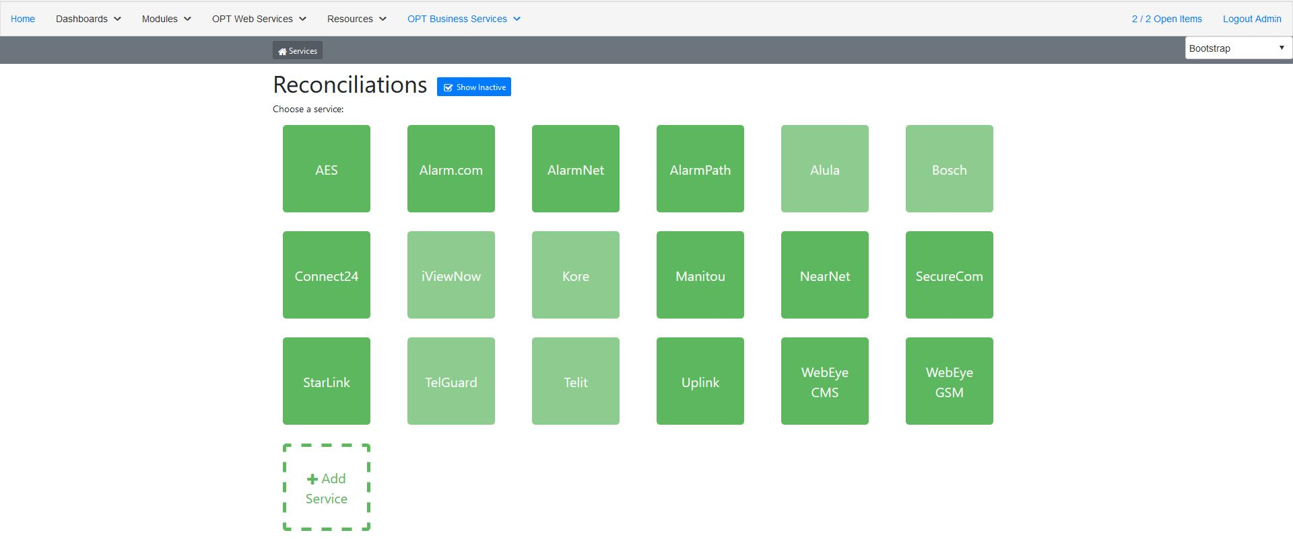
SRM Services
Notes:
OPT Services Reconciliation Module (SRM)
Upload your 3rd Party electronic invoices to OPT Web Services for reconciliation of the invoice to your accounts in SedonaOffice.
Map out the data to match the alarm account or secondary alarm account information in SedonaOffice to the related information in the invoice.
Exception dashboards allow you to see unresolved accounts and link possible matches from the dashboard instantly.
Unreconciled items remain in the exception list until resolved manually.
Create a Task in the OPT Customer Task Management Module (CTM) directly from a possible exception match in the dashboard, and assign it to the person who needs to investigate the account further until it is successfully resolved.

Slide 22
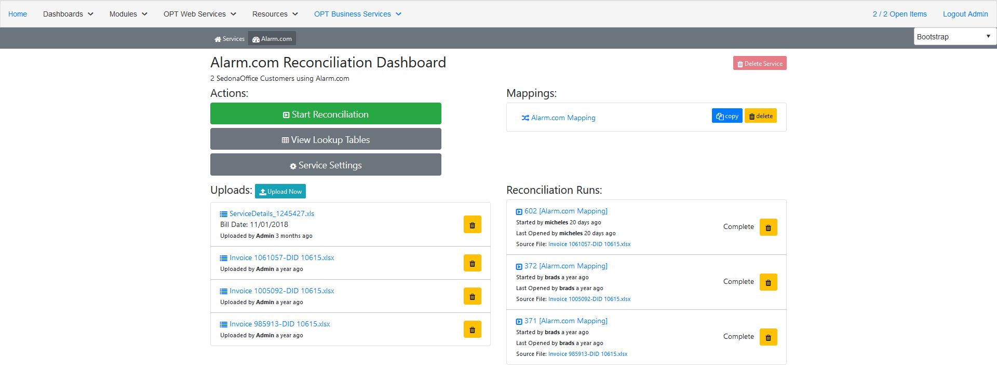
SRM Service Dashboard
Notes:
OPT Services Reconciliation Module (SRM)
Upload your 3rd Party electronic invoices to OPT Web Services for reconciliation of the invoice to your accounts in SedonaOffice.
Map out the data to match the alarm account or secondary alarm account information in SedonaOffice to the related information in the invoice.
Exception dashboards allow you to see unresolved accounts and link possible matches from the dashboard instantly.
Unreconciled items remain in the exception list until resolved manually.
Create a Task in the OPT Customer Task Management Module (CTM) directly from a possible exception match in the dashboard, and assign it to the person who needs to investigate the account further until it is successfully resolved.

Slide 23
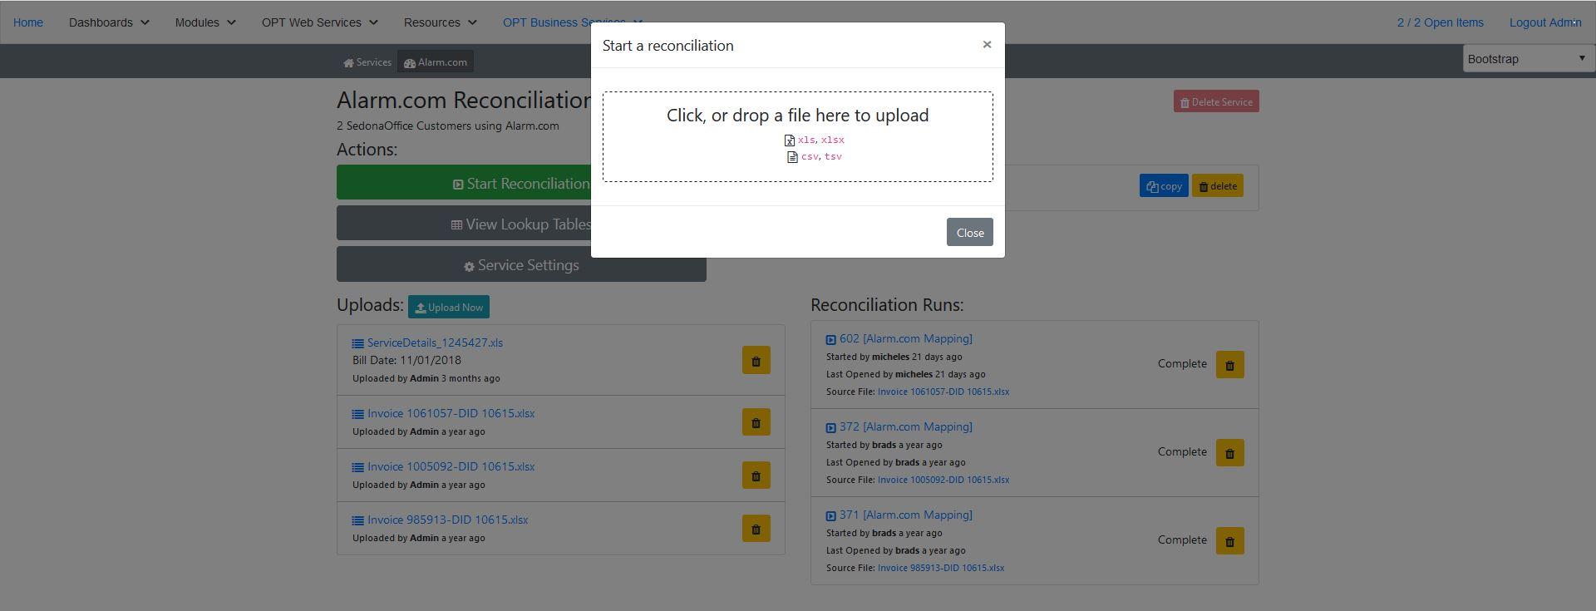
Upload Bill Data
Notes:
OPT Services Reconciliation Module (SRM)
Upload your 3rd Party electronic invoices to OPT Web Services for reconciliation of the invoice to your accounts in SedonaOffice.
Map out the data to match the alarm account or secondary alarm account information in SedonaOffice to the related information in the invoice.
Exception dashboards allow you to see unresolved accounts and link possible matches from the dashboard instantly.
Unreconciled items remain in the exception list until resolved manually.
Create a Task in the OPT Customer Task Management Module (CTM) directly from a possible exception match in the dashboard, and assign it to the person who needs to investigate the account further until it is successfully resolved.

Slide 24
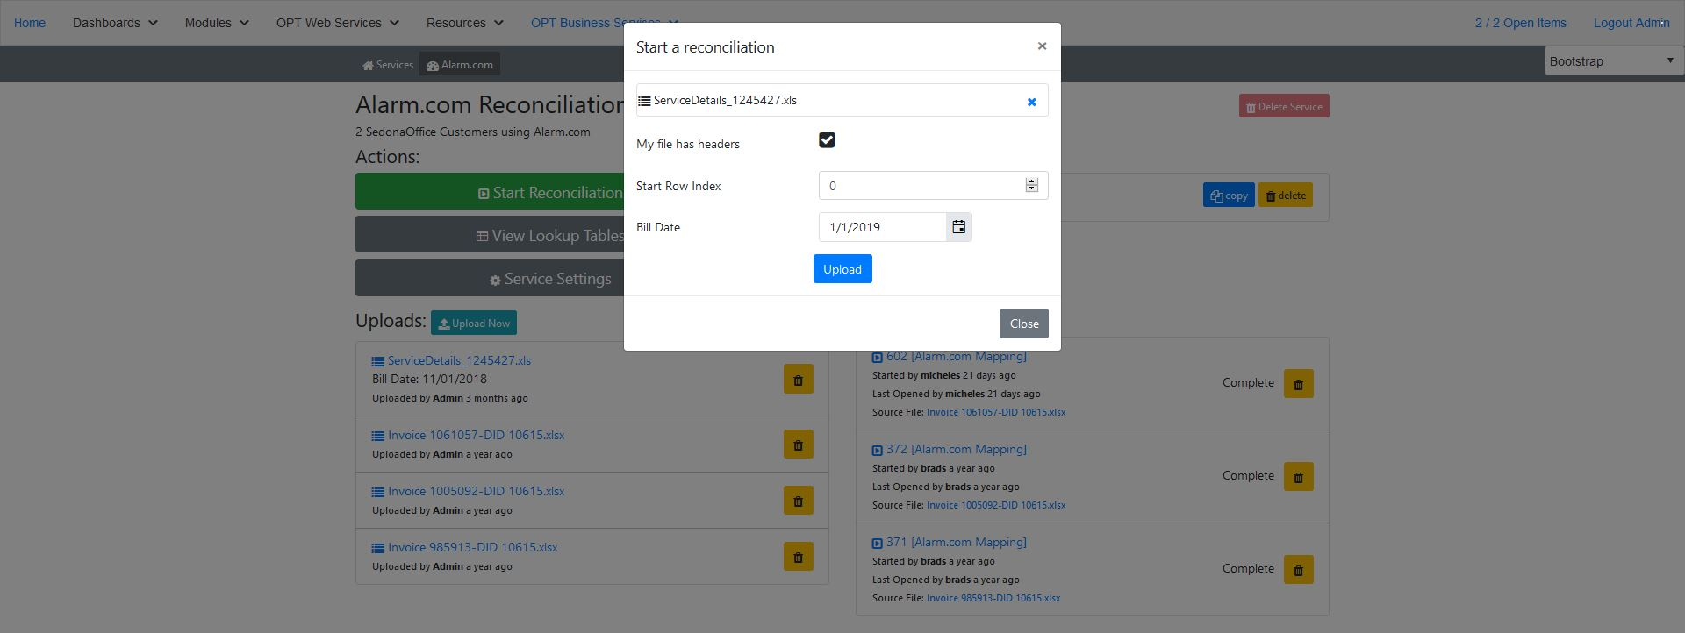
Select Bill Date
Notes:
OPT Services Reconciliation Module (SRM)
Upload your 3rd Party electronic invoices to OPT Web Services for reconciliation of the invoice to your accounts in SedonaOffice.
Map out the data to match the alarm account or secondary alarm account information in SedonaOffice to the related information in the invoice.
Exception dashboards allow you to see unresolved accounts and link possible matches from the dashboard instantly.
Unreconciled items remain in the exception list until resolved manually.
Create a Task in the OPT Customer Task Management Module (CTM) directly from a possible exception match in the dashboard, and assign it to the person who needs to investigate the account further until it is successfully resolved.

Slide 25
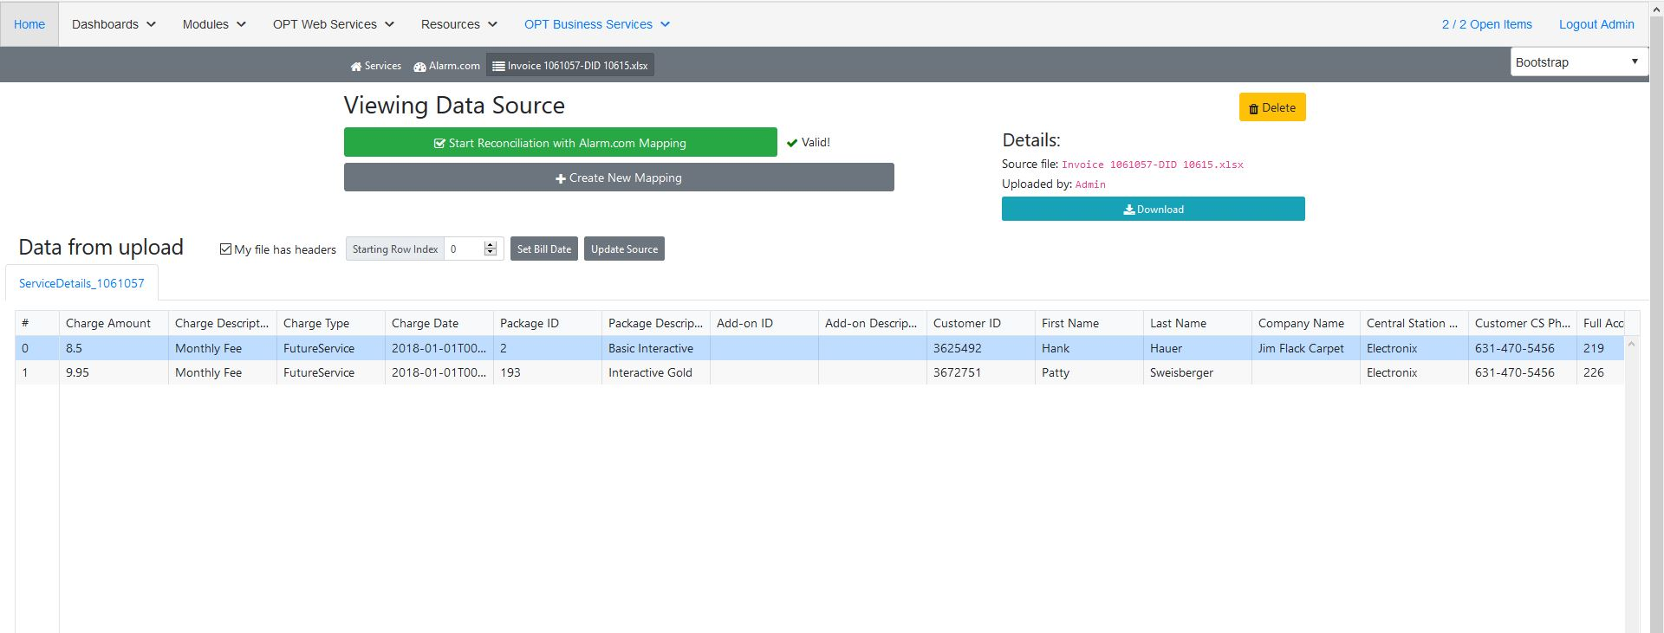
Validate Bill & Start SRM
Notes:
OPT Services Reconciliation Module (SRM)
Upload your 3rd Party electronic invoices to OPT Web Services for reconciliation of the invoice to your accounts in SedonaOffice.
Map out the data to match the alarm account or secondary alarm account information in SedonaOffice to the related information in the invoice.
Exception dashboards allow you to see unresolved accounts and link possible matches from the dashboard instantly.
Unreconciled items remain in the exception list until resolved manually.
Create a Task in the OPT Customer Task Management Module (CTM) directly from a possible exception match in the dashboard, and assign it to the person who needs to investigate the account further until it is successfully resolved.

Slide 26
OPT Services Reconciliation Module (SRM)
Using the SRM exceptions dashboard.

Slide 27
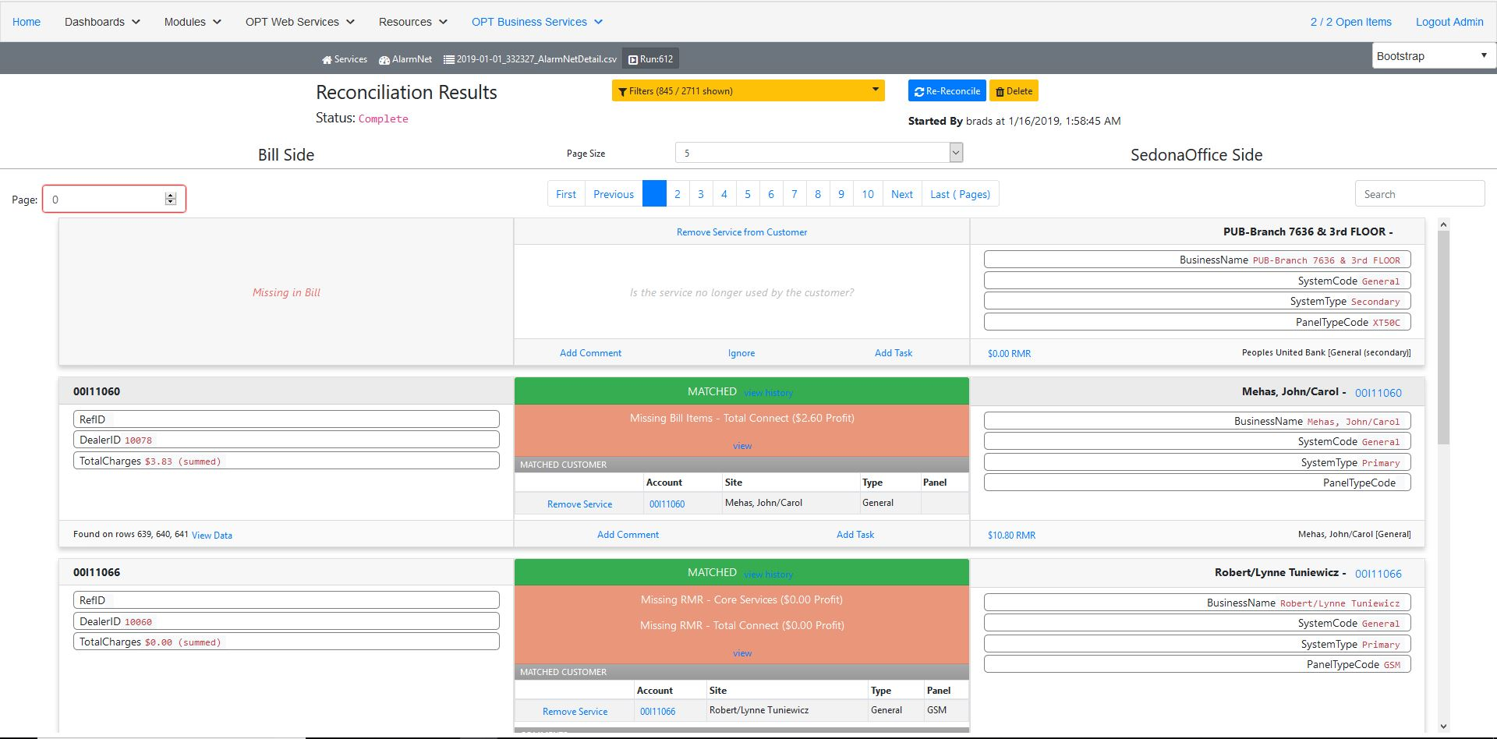
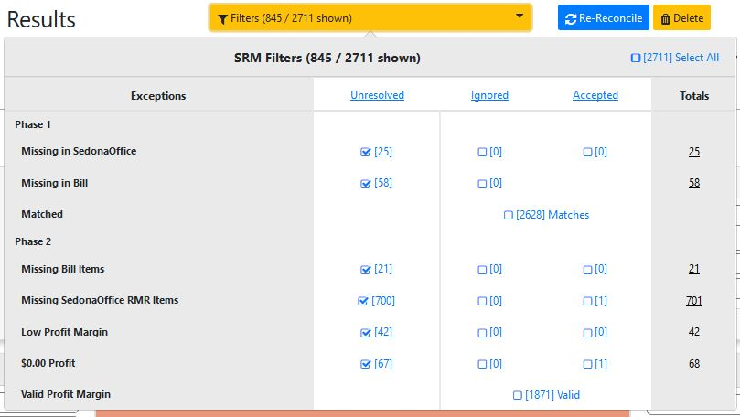
SRM Exception Dashboard
The exceptions are broken down into two Phases.
Phase 1: Checks to make sure that the accounts are loaded in both systems.
Phase 2: Then checks that the bill items match up to SedonaOffice RMR items.
Phase 2 – Missing Bill Items
The expected invoice item based on the RMR code
could not be found in the bill.
Phase 2 – Missing SedonaOffice RMR Items
The expected RMR on the customer could not be
found for the invoice item from the bill.
Phase 2 – Low Profit Margin
The markup on the SedonaOffice RMR items does
not meet the minimum threshold.
Phase 2 – $0.00 Profit
This exception indicates that we are not making
any profit on line item.
Phase 2 – Valid Profit Margin
These are line items are marked up correctly and
require no further action.
Phase 1 – Missing in SedonaOffice
These are accounts that we found in the bill that do not match up to a SedonaOffice system.
Phase 1 – Missing in Bill
These are accounts that were reconciled at one point but now are missing from the bill.
Phase 1 – Matched
These accounts exist on both side and does not require any action.
The Filters menu contains the list of the different exceptions messages. This is the first stop to check what is going on with the reconciliation.
Notes:
OPT Services Reconciliation Module (SRM)
Upload your 3rd Party electronic invoices to OPT Web Services for reconciliation of the invoice to your accounts in SedonaOffice.
Map out the data to match the alarm account or secondary alarm account information in SedonaOffice to the related information in the invoice.
Exception dashboards allow you to see unresolved accounts and link possible matches from the dashboard instantly.
Unreconciled items remain in the exception list until resolved manually.
Create a Task in the OPT Customer Task Management Module (CTM) directly from a possible exception match in the dashboard, and assign it to the person who needs to investigate the account further until it is successfully resolved.

Slide 28
Phase 1 Exception: Missing in Missing in Bill
Phase 1 Exception: Missing in Missing in SedonaOffice

Slide 29
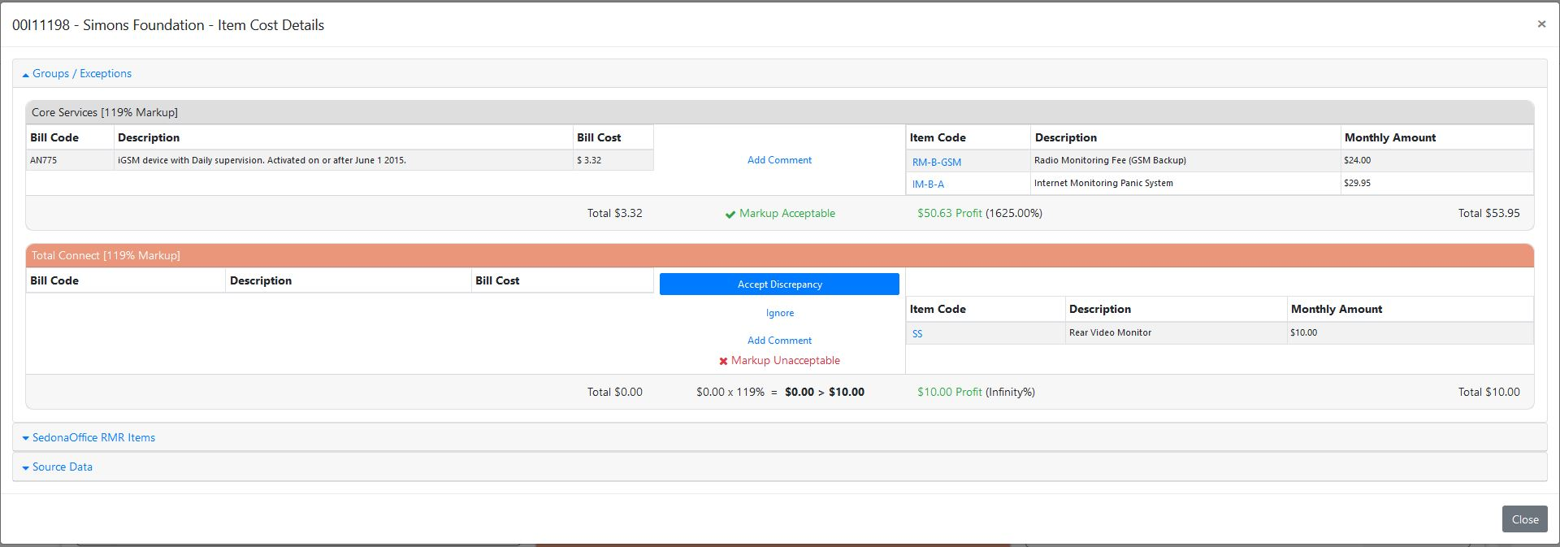
Phase 2 Exception: Missing Bill Item

Slide 30
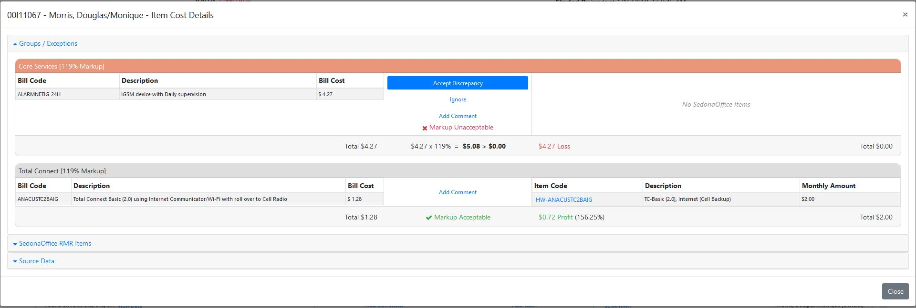
Phase 2 Exception: Missing SedonaOffice RMR Item

Slide 31
Phase 2 Exception: Low Profit Margin

Slide 32
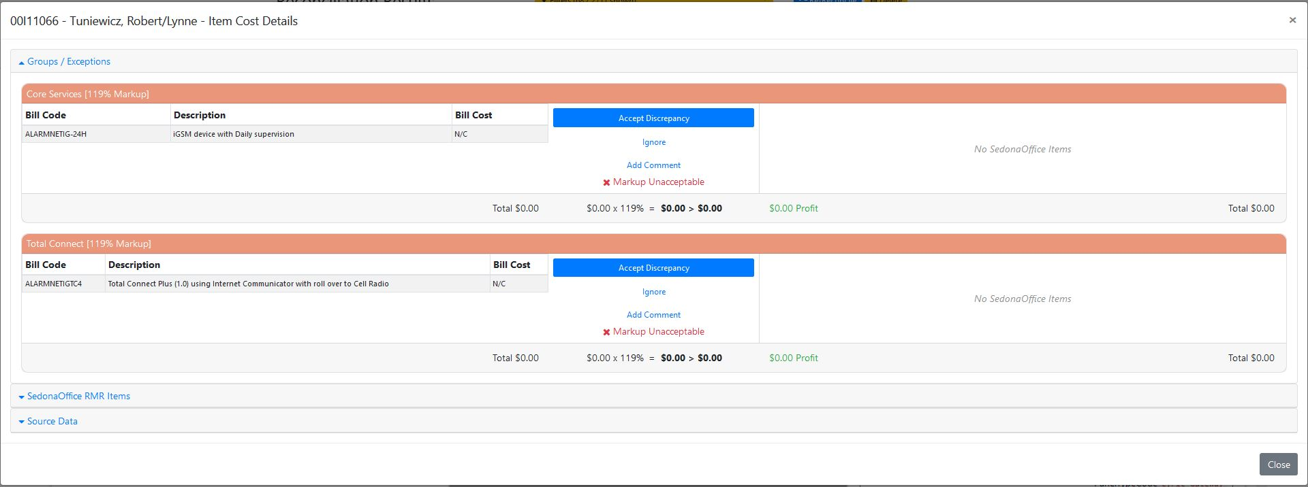
Phase 2 Exception: $0.00 Profit or No Charges

Slide 33
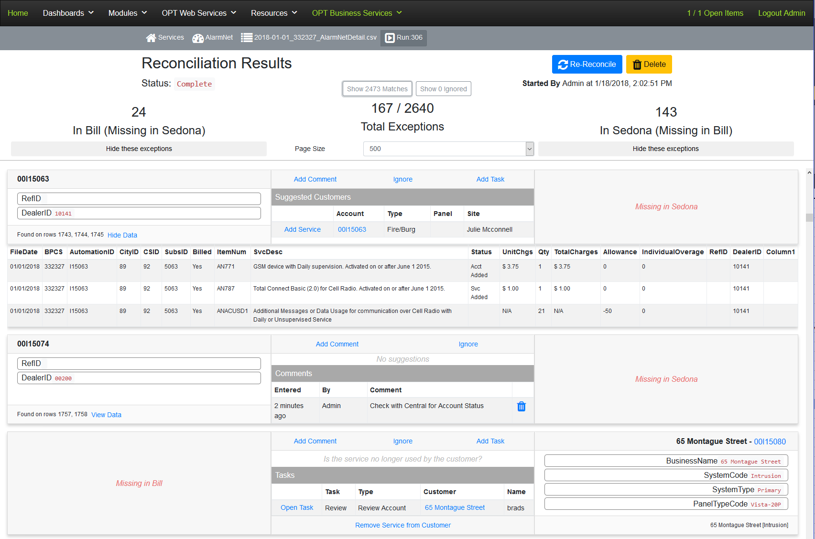
View Bill Data
View all the bill details regarding this account by clicking on View Data. All the charges and other information that was available in the upload will be present.
Notes:
OPT Services Reconciliation Module (SRM)
Upload your 3rd Party electronic invoices to OPT Web Services for reconciliation of the invoice to your accounts in SedonaOffice.
Map out the data to match the alarm account or secondary alarm account information in SedonaOffice to the related information in the invoice.
Exception dashboards allow you to see unresolved accounts and link possible matches from the dashboard instantly.
Unreconciled items remain in the exception list until resolved manually.
Create a Task in the OPT Customer Task Management Module (CTM) directly from a possible exception match in the dashboard, and assign it to the person who needs to investigate the account further until it is successfully resolved.

Slide 34
Ignore Button
If this item is to be ignored for this bill then simply click the ignore button. However on the next reconciliation if the item still exists it will reappear.
Notes:
OPT Services Reconciliation Module (SRM)
Upload your 3rd Party electronic invoices to OPT Web Services for reconciliation of the invoice to your accounts in SedonaOffice.
Map out the data to match the alarm account or secondary alarm account information in SedonaOffice to the related information in the invoice.
Exception dashboards allow you to see unresolved accounts and link possible matches from the dashboard instantly.
Unreconciled items remain in the exception list until resolved manually.
Create a Task in the OPT Customer Task Management Module (CTM) directly from a possible exception match in the dashboard, and assign it to the person who needs to investigate the account further until it is successfully resolved.

Slide 35
Add Service Button
As of Phase 2, SRM will try to automatically match the system in SedonaOffice. If SRM cannot match a system then it will try to make a suggestion as to the account that should be matched. If this is the correct match then we can add the service to this account which will allow it to be automatically reconciled in the future.
Notes:
OPT Services Reconciliation Module (SRM)
Upload your 3rd Party electronic invoices to OPT Web Services for reconciliation of the invoice to your accounts in SedonaOffice.
Map out the data to match the alarm account or secondary alarm account information in SedonaOffice to the related information in the invoice.
Exception dashboards allow you to see unresolved accounts and link possible matches from the dashboard instantly.
Unreconciled items remain in the exception list until resolved manually.
Create a Task in the OPT Customer Task Management Module (CTM) directly from a possible exception match in the dashboard, and assign it to the person who needs to investigate the account further until it is successfully resolved.

Slide 36
Preview System Button
By clicking on the account number you can drill down to verify that this is the correct customer and that the recurring is loaded before adding the service and accepting the reconciliation.
Notes:
OPT Services Reconciliation Module (SRM)
Upload your 3rd Party electronic invoices to OPT Web Services for reconciliation of the invoice to your accounts in SedonaOffice.
Map out the data to match the alarm account or secondary alarm account information in SedonaOffice to the related information in the invoice.
Exception dashboards allow you to see unresolved accounts and link possible matches from the dashboard instantly.
Unreconciled items remain in the exception list until resolved manually.
Create a Task in the OPT Customer Task Management Module (CTM) directly from a possible exception match in the dashboard, and assign it to the person who needs to investigate the account further until it is successfully resolved.

Slide 37
Add Comment Button
While working the reconciliation exceptions dashboard you can quickly add temporary comments that will be available until the reconciliation is complete.
Notes:
OPT Services Reconciliation Module (SRM)
Upload your 3rd Party electronic invoices to OPT Web Services for reconciliation of the invoice to your accounts in SedonaOffice.
Map out the data to match the alarm account or secondary alarm account information in SedonaOffice to the related information in the invoice.
Exception dashboards allow you to see unresolved accounts and link possible matches from the dashboard instantly.
Unreconciled items remain in the exception list until resolved manually.
Create a Task in the OPT Customer Task Management Module (CTM) directly from a possible exception match in the dashboard, and assign it to the person who needs to investigate the account further until it is successfully resolved.

Slide 38
Add Task Button
If you need to follow up or assign a task to someone else to resolve the issue, simply hit add task. This will allow you to create an OPT Customer Task. The assigned user will receive and email informing them of their open task.
Notes:
OPT Services Reconciliation Module (SRM)
Upload your 3rd Party electronic invoices to OPT Web Services for reconciliation of the invoice to your accounts in SedonaOffice.
Map out the data to match the alarm account or secondary alarm account information in SedonaOffice to the related information in the invoice.
Exception dashboards allow you to see unresolved accounts and link possible matches from the dashboard instantly.
Unreconciled items remain in the exception list until resolved manually.
Create a Task in the OPT Customer Task Management Module (CTM) directly from a possible exception match in the dashboard, and assign it to the person who needs to investigate the account further until it is successfully resolved.

Slide 39
Remove Service Button
If the item was previously reconciled and is no longer on the bill, then you can remove the service and SRM will not try to reconcile it in the future.
Notes:
OPT Services Reconciliation Module (SRM)
Upload your 3rd Party electronic invoices to OPT Web Services for reconciliation of the invoice to your accounts in SedonaOffice.
Map out the data to match the alarm account or secondary alarm account information in SedonaOffice to the related information in the invoice.
Exception dashboards allow you to see unresolved accounts and link possible matches from the dashboard instantly.
Unreconciled items remain in the exception list until resolved manually.
Create a Task in the OPT Customer Task Management Module (CTM) directly from a possible exception match in the dashboard, and assign it to the person who needs to investigate the account further until it is successfully resolved.

Slide 40
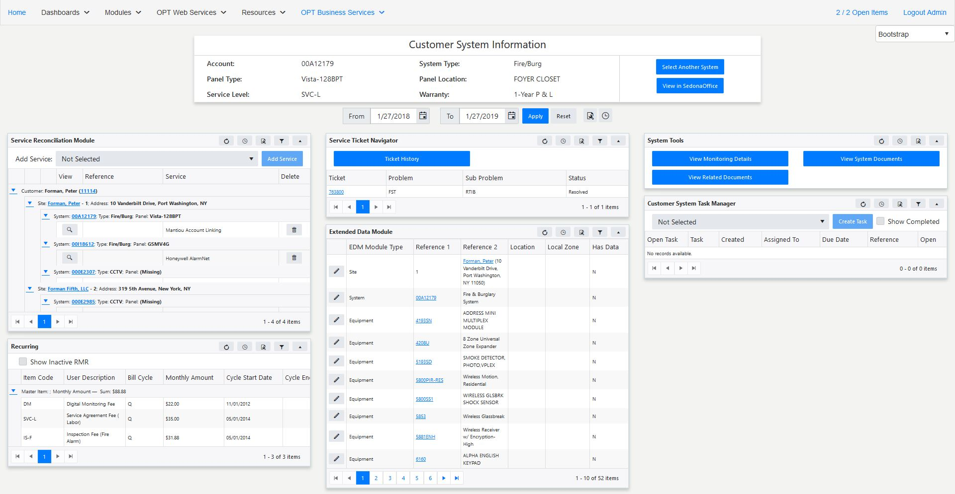
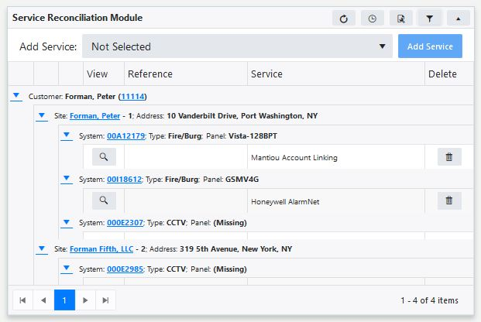
Customer SRM Module
Quickly add and remove services to your SedonaOffice system accounts and view previous reconciled bill data.
Notes:
OPT Services Reconciliation Module (SRM)
Upload your 3rd Party electronic invoices to OPT Web Services for reconciliation of the invoice to your accounts in SedonaOffice.
Map out the data to match the alarm account or secondary alarm account information in SedonaOffice to the related information in the invoice.
Exception dashboards allow you to see unresolved accounts and link possible matches from the dashboard instantly.
Unreconciled items remain in the exception list until resolved manually.
Create a Task in the OPT Customer Task Management Module (CTM) directly from a possible exception match in the dashboard, and assign it to the person who needs to investigate the account further until it is successfully resolved.

Slide 41
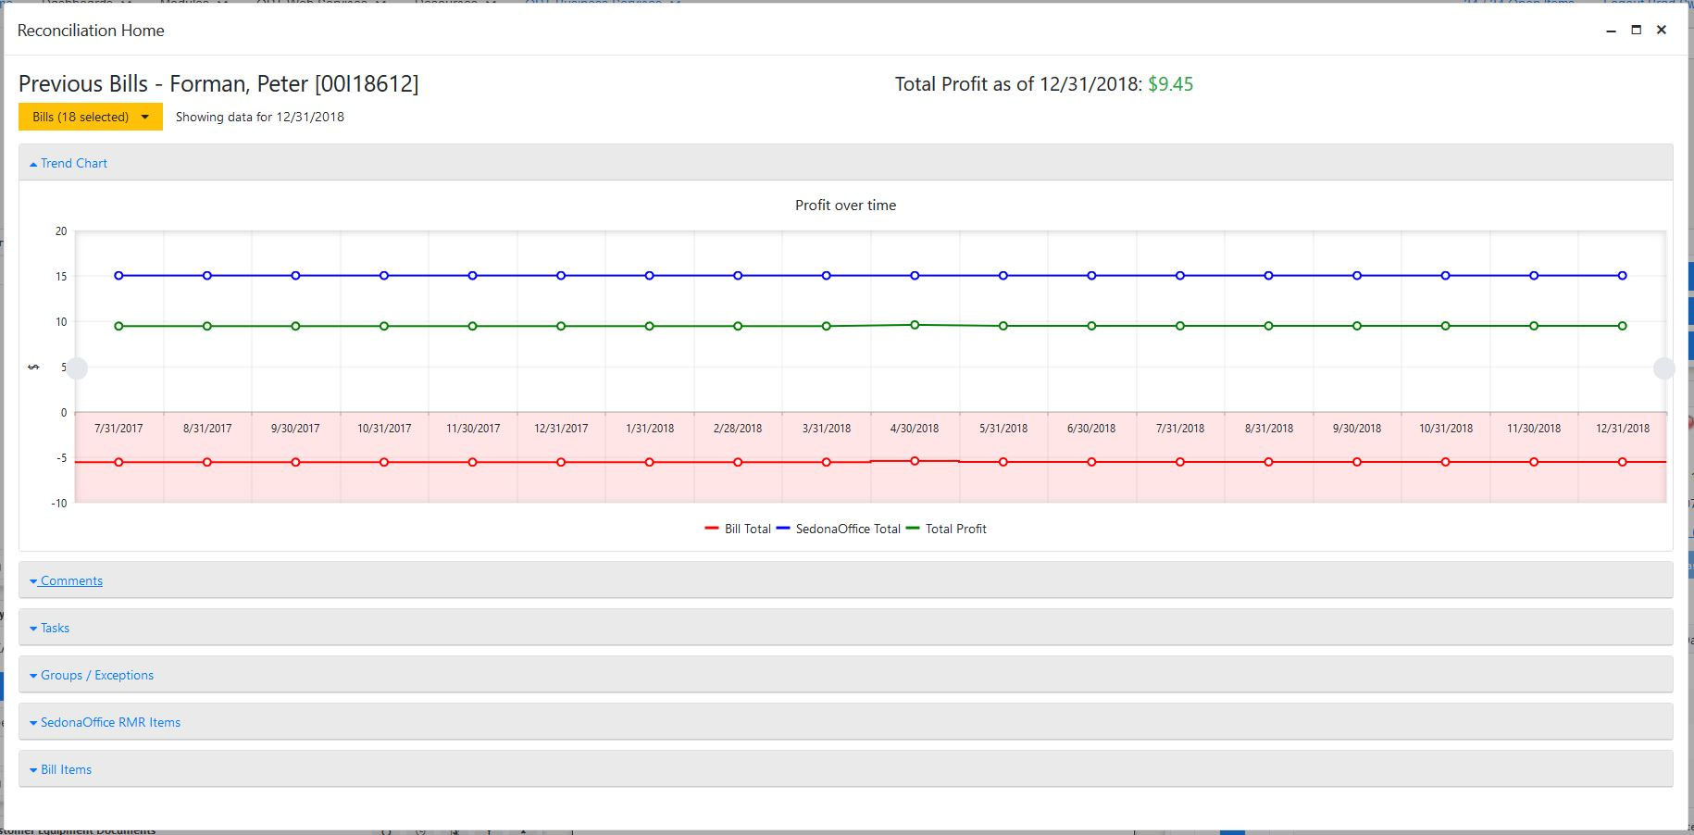
Select Bills to Analyze
View trend analysis, previous comments/tasks, exceptions, current RMR and bill items.
Previous reconciled bill information can be viewed from the SRM panel on OPT Web Services. Use the Bills dropdown to select which bills you would like to include.
Notes:
OPT Services Reconciliation Module (SRM)
Upload your 3rd Party electronic invoices to OPT Web Services for reconciliation of the invoice to your accounts in SedonaOffice.
Map out the data to match the alarm account or secondary alarm account information in SedonaOffice to the related information in the invoice.
Exception dashboards allow you to see unresolved accounts and link possible matches from the dashboard instantly.
Unreconciled items remain in the exception list until resolved manually.
Create a Task in the OPT Customer Task Management Module (CTM) directly from a possible exception match in the dashboard, and assign it to the person who needs to investigate the account further until it is successfully resolved.

Slide 42
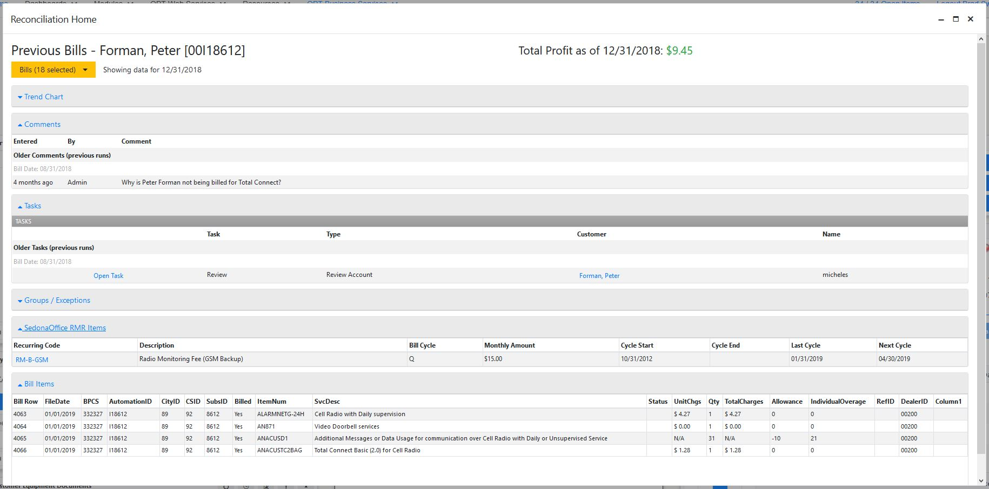
SRM Customer Analysis
View trend analysis, previous comments/tasks, exceptions, current RMR and bill items.
Notes:
OPT Services Reconciliation Module (SRM)
Upload your 3rd Party electronic invoices to OPT Web Services for reconciliation of the invoice to your accounts in SedonaOffice.
Map out the data to match the alarm account or secondary alarm account information in SedonaOffice to the related information in the invoice.
Exception dashboards allow you to see unresolved accounts and link possible matches from the dashboard instantly.
Unreconciled items remain in the exception list until resolved manually.
Create a Task in the OPT Customer Task Management Module (CTM) directly from a possible exception match in the dashboard, and assign it to the person who needs to investigate the account further until it is successfully resolved.

Slide 43
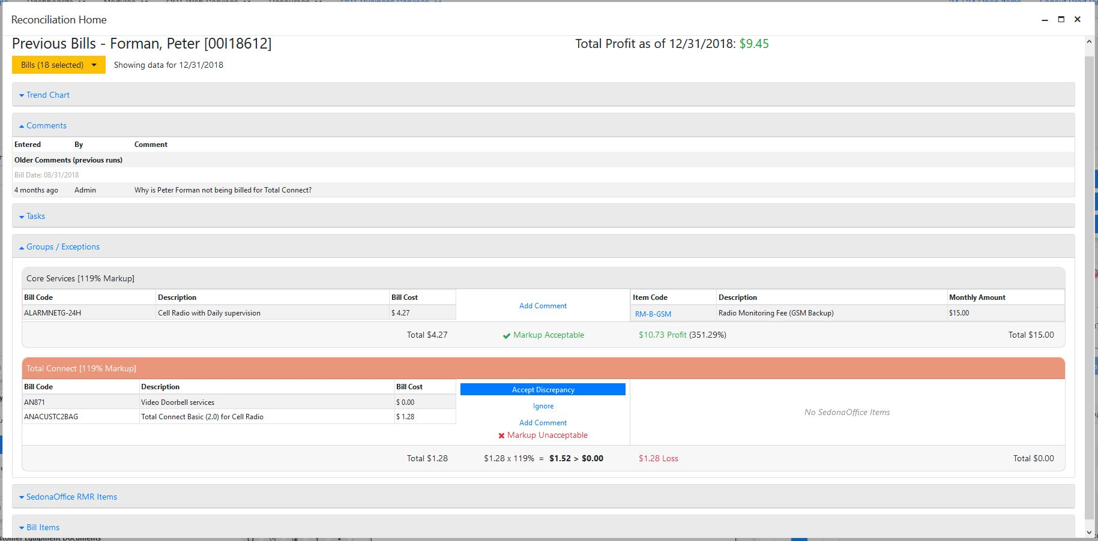
SRM Customer Analysis
View trend analysis, previous comments/tasks, exceptions, current RMR and bill items.
Notes:
OPT Services Reconciliation Module (SRM)
Upload your 3rd Party electronic invoices to OPT Web Services for reconciliation of the invoice to your accounts in SedonaOffice.
Map out the data to match the alarm account or secondary alarm account information in SedonaOffice to the related information in the invoice.
Exception dashboards allow you to see unresolved accounts and link possible matches from the dashboard instantly.
Unreconciled items remain in the exception list until resolved manually.
Create a Task in the OPT Customer Task Management Module (CTM) directly from a possible exception match in the dashboard, and assign it to the person who needs to investigate the account further until it is successfully resolved.

Slide 44
OPT Services Reconciliation Module (SRM)
Configurating the SRM service and mapping files.

Slide 45
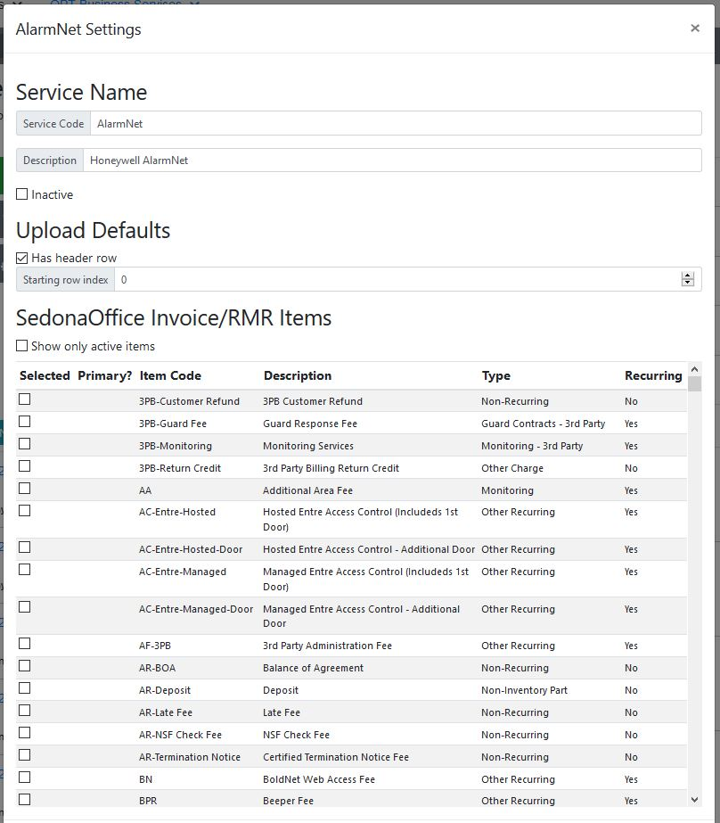
SRM Service Setup and RMR Items

Slide 46
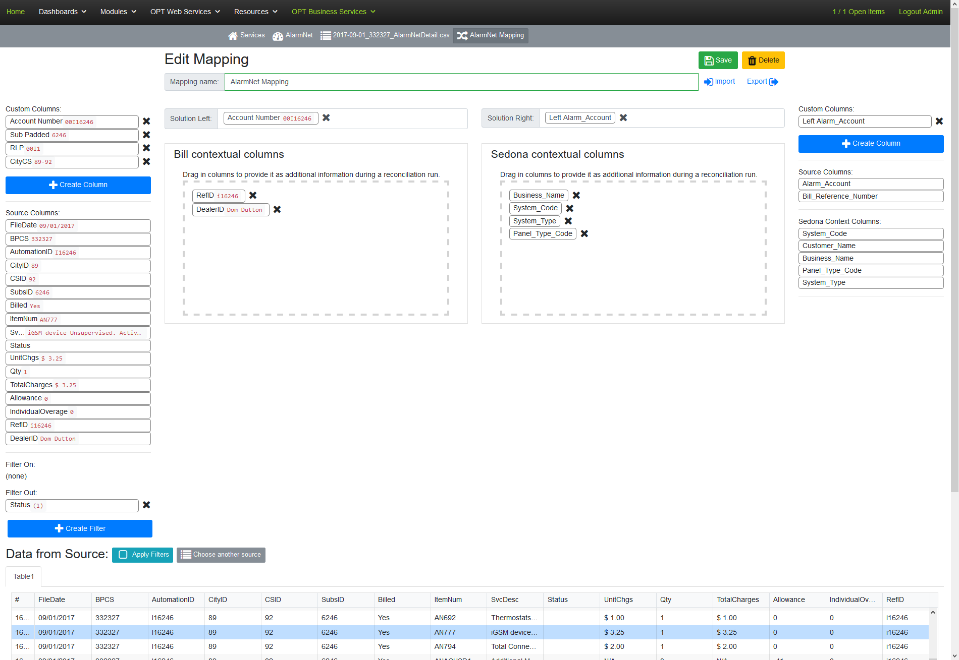
SRM Mapping Setup
Extract Data to Build a Group Number
Group numbers can be a receiver phone number, IP address or other grouping data.
[CityCS] = Concatenate (
[CityID] ,
“-” ,
[CSID]
)
= “69-92”
Notes:
OPT Services Reconciliation Module (SRM)
Upload your 3rd Party electronic invoices to OPT Web Services for reconciliation of the invoice to your accounts in SedonaOffice.
Map out the data to match the alarm account or secondary alarm account information in SedonaOffice to the related information in the invoice.
Exception dashboards allow you to see unresolved accounts and link possible matches from the dashboard instantly.
Unreconciled items remain in the exception list until resolved manually.
Create a Task in the OPT Customer Task Management Module (CTM) directly from a possible exception match in the dashboard, and assign it to the person who needs to investigate the account further until it is successfully resolved.

Slide 47
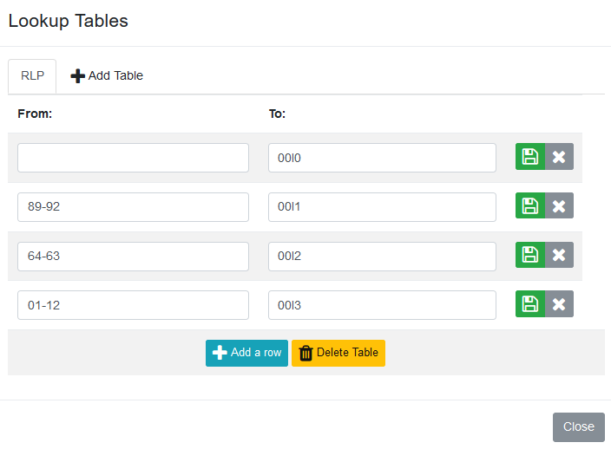
SRM Mapping Setup
Map the Group Number to a Prefix
Store a account number prefix list with the mapping utility.
[RLP] = Lookup (
[CityCS] ,
)
“89-92”
= “00I1”
Notes:
OPT Services Reconciliation Module (SRM)
Upload your 3rd Party electronic invoices to OPT Web Services for reconciliation of the invoice to your accounts in SedonaOffice.
Map out the data to match the alarm account or secondary alarm account information in SedonaOffice to the related information in the invoice.
Exception dashboards allow you to see unresolved accounts and link possible matches from the dashboard instantly.
Unreconciled items remain in the exception list until resolved manually.
Create a Task in the OPT Customer Task Management Module (CTM) directly from a possible exception match in the dashboard, and assign it to the person who needs to investigate the account further until it is successfully resolved.

Slide 48
SRM Mapping Setup
Extract and Pad the Unique Bill Reference
Find and adjust the account number in the bill to match with your data format. (IE “0” Pad to 4 digits)
[Sub Padded] = LeftPad (
[SubsID] ,
4 , “0” )
= “6246”
Notes:
OPT Services Reconciliation Module (SRM)
Upload your 3rd Party electronic invoices to OPT Web Services for reconciliation of the invoice to your accounts in SedonaOffice.
Map out the data to match the alarm account or secondary alarm account information in SedonaOffice to the related information in the invoice.
Exception dashboards allow you to see unresolved accounts and link possible matches from the dashboard instantly.
Unreconciled items remain in the exception list until resolved manually.
Create a Task in the OPT Customer Task Management Module (CTM) directly from a possible exception match in the dashboard, and assign it to the person who needs to investigate the account further until it is successfully resolved.

Slide 49
SRM Mapping Setup
[Account Number] = Concatenate (
)
[RLP] ,
[Sub Padded]
= “00I16246”
Bring it All Together
Take the individual components and merge them as the account number to be used for the matching.
Notes:
OPT Services Reconciliation Module (SRM)
Upload your 3rd Party electronic invoices to OPT Web Services for reconciliation of the invoice to your accounts in SedonaOffice.
Map out the data to match the alarm account or secondary alarm account information in SedonaOffice to the related information in the invoice.
Exception dashboards allow you to see unresolved accounts and link possible matches from the dashboard instantly.
Unreconciled items remain in the exception list until resolved manually.
Create a Task in the OPT Customer Task Management Module (CTM) directly from a possible exception match in the dashboard, and assign it to the person who needs to investigate the account further until it is successfully resolved.

Slide 50
SRM Mapping Setup
[Left Account Number] = Left (
, 8 )
[Alarm_Account]
= “00I16246”
Get the SedonaOffice Account Number
It may be necessary to adjust the SedonaOffice alarm account number to match. In this case I only want to match on the first 8 characters, ignoring any characters that may follow.
Notes:
OPT Services Reconciliation Module (SRM)
Upload your 3rd Party electronic invoices to OPT Web Services for reconciliation of the invoice to your accounts in SedonaOffice.
Map out the data to match the alarm account or secondary alarm account information in SedonaOffice to the related information in the invoice.
Exception dashboards allow you to see unresolved accounts and link possible matches from the dashboard instantly.
Unreconciled items remain in the exception list until resolved manually.
Create a Task in the OPT Customer Task Management Module (CTM) directly from a possible exception match in the dashboard, and assign it to the person who needs to investigate the account further until it is successfully resolved.

Slide 51
SRM Mapping Setup
Available Tools
CONCAT : Append values from other columns and static text together.
LEFT : Use a certain number of characters from the left side of a string.
LEFTPAD : Add characters to the left side of the string to create a string of the desired length.
SUBSTRING : Pull characters from the value in the given column (startIndex, endIndex).
RIGHT : Use a certain number of characters from the right side of a string.
RIGHTPAD : Add characters to the right side of the string to create a string of the desired length.
LOOKUP : Use the given lookup table to replace a value with one from the table.
TRIM : Trim whitespace off the start and end of a string.
REPLACE : Search and replace a string in the given column.
FILTER_ON : Include the row in the reconciliation if it matches any of the associated rules.
FILTER_OUT : Exclude a row from the reconciliation if matches any of the associated rules.
Note: FILTER_OUT overrides FILTER_ON.
Notes:
OPT Services Reconciliation Module (SRM)
Upload your 3rd Party electronic invoices to OPT Web Services for reconciliation of the invoice to your accounts in SedonaOffice.
Map out the data to match the alarm account or secondary alarm account information in SedonaOffice to the related information in the invoice.
Exception dashboards allow you to see unresolved accounts and link possible matches from the dashboard instantly.
Unreconciled items remain in the exception list until resolved manually.
Create a Task in the OPT Customer Task Management Module (CTM) directly from a possible exception match in the dashboard, and assign it to the person who needs to investigate the account further until it is successfully resolved.

Slide 52
SRM Mapping Setup
Now Select Both Columns to Compare
After adjusting the data now we take the compiled output from both sides and select them as the solution columns.
Notes:
OPT Services Reconciliation Module (SRM)
Upload your 3rd Party electronic invoices to OPT Web Services for reconciliation of the invoice to your accounts in SedonaOffice.
Map out the data to match the alarm account or secondary alarm account information in SedonaOffice to the related information in the invoice.
Exception dashboards allow you to see unresolved accounts and link possible matches from the dashboard instantly.
Unreconciled items remain in the exception list until resolved manually.
Create a Task in the OPT Customer Task Management Module (CTM) directly from a possible exception match in the dashboard, and assign it to the person who needs to investigate the account further until it is successfully resolved.

Slide 53
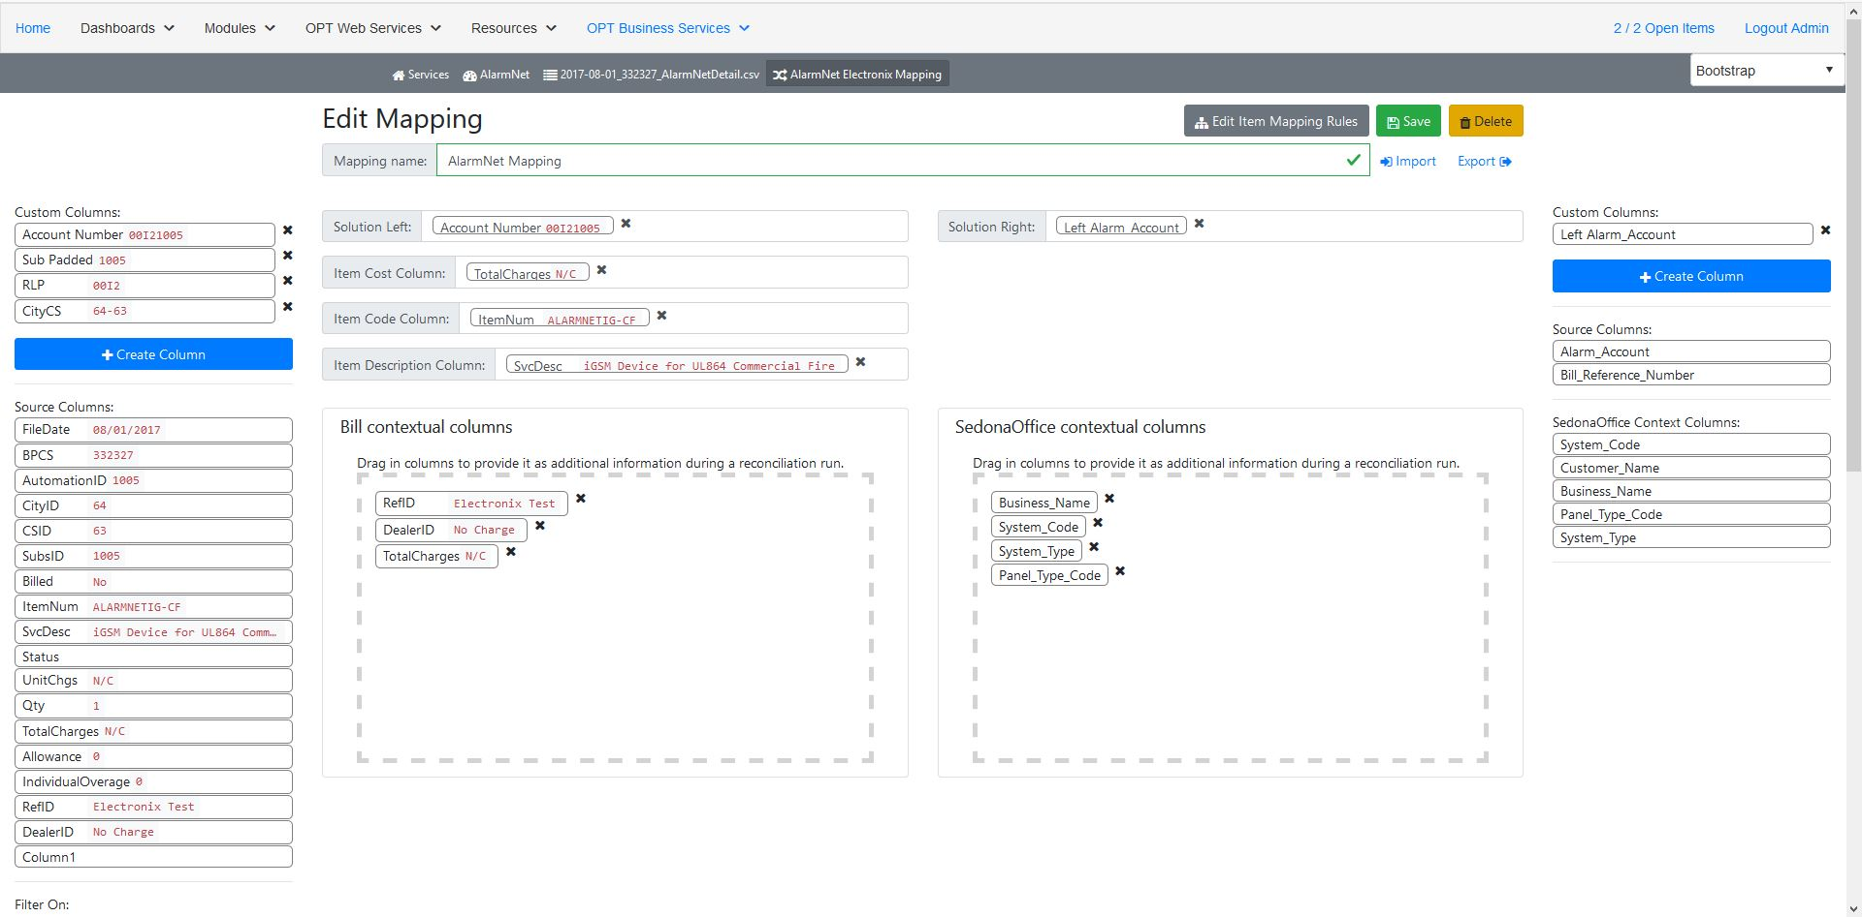
SRM Mapping Setup
Phase 2 Mapping
We will also point to the Item Cost, Item Code, and Description. Once that is selected then we will need to map the individual item codes to the SedonaOffice RMR using the Item Mapper above.
Notes:
OPT Services Reconciliation Module (SRM)
Upload your 3rd Party electronic invoices to OPT Web Services for reconciliation of the invoice to your accounts in SedonaOffice.
Map out the data to match the alarm account or secondary alarm account information in SedonaOffice to the related information in the invoice.
Exception dashboards allow you to see unresolved accounts and link possible matches from the dashboard instantly.
Unreconciled items remain in the exception list until resolved manually.
Create a Task in the OPT Customer Task Management Module (CTM) directly from a possible exception match in the dashboard, and assign it to the person who needs to investigate the account further until it is successfully resolved.

Slide 54
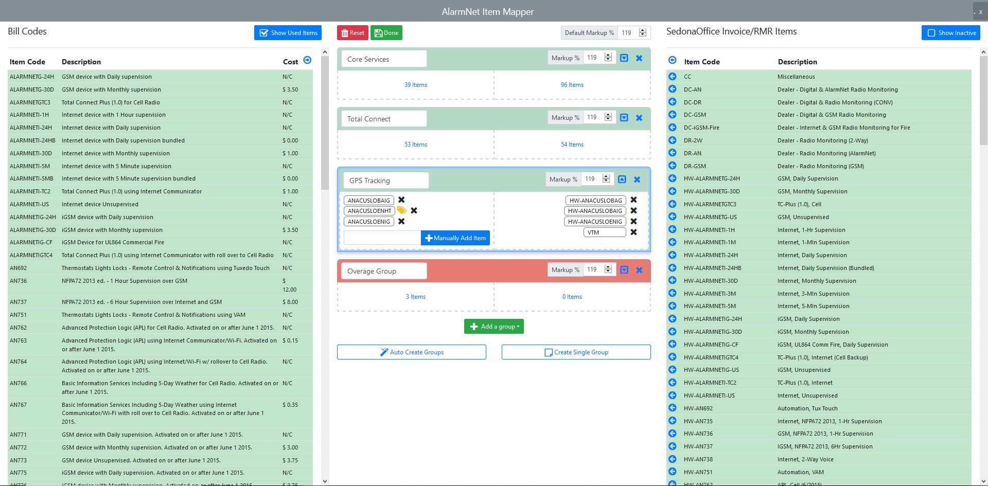
SRM Mapping Setup
Create Reconciliation Groups by selecting bill codes and the matching RMR codes. Then set the markup threshold.
Notes:
OPT Services Reconciliation Module (SRM)
Upload your 3rd Party electronic invoices to OPT Web Services for reconciliation of the invoice to your accounts in SedonaOffice.
Map out the data to match the alarm account or secondary alarm account information in SedonaOffice to the related information in the invoice.
Exception dashboards allow you to see unresolved accounts and link possible matches from the dashboard instantly.
Unreconciled items remain in the exception list until resolved manually.
Create a Task in the OPT Customer Task Management Module (CTM) directly from a possible exception match in the dashboard, and assign it to the person who needs to investigate the account further until it is successfully resolved.

Slide 55
OPT Services Reconciliation Module (SRM)
SRM Phase 1
Support for Over 15 Industry Leading Service Providers
Upload Invoices or Account Lists in Excel, CSV or Text formats.
Customizable and Flexible Mapping System
Bill Account to SedonaOffice System Account Matching
System Service Tracking
Exceptions Dashboard
Bill Reconciliation History
Additional Provider Support Available Upon Request
Notes:
OPT Services Reconciliation Module (SRM)
Upload your 3rd Party electronic invoices to OPT Web Services for reconciliation of the invoice to your accounts in SedonaOffice.
Map out the data to match the alarm account or secondary alarm account information in SedonaOffice to the related information in the invoice.
Exception dashboards allow you to see unresolved accounts and link possible matches from the dashboard instantly.
Unreconciled items remain in the exception list until resolved manually.
Create a Task in the OPT Customer Task Management Module (CTM) directly from a possible exception match in the dashboard, and assign it to the person who needs to investigate the account further until it is successfully resolved.

Slide 56
OPT Services Reconciliation Module (SRM)
SRM Phase 2
Total Customer System RMR to Total Bill Cost Comparison
Is the Total RMR > the Total Cost on the Bill?
Recurring Must be Loaded on the System Record
SRM will only compare total cost from approved SedonaOffice Recurring Item Codes as specified in the SRM setup for each service provider.
Customer System RMR to Bill Line Item Cost Comparison
Is the Recurring Line > the Bill Line Item?
SRM will provide a 1:1 mapping from the Bill Invoice Items to SedonaOffice Recurring Item Codes for each service provider.
Create and Reconcile Your Own Custom Providers and Services
Customer Level Statistics with Trend Analysis and History
Notes:
OPT Services Reconciliation Module (SRM)
Upload your 3rd Party electronic invoices to OPT Web Services for reconciliation of the invoice to your accounts in SedonaOffice.
Map out the data to match the alarm account or secondary alarm account information in SedonaOffice to the related information in the invoice.
Exception dashboards allow you to see unresolved accounts and link possible matches from the dashboard instantly.
Unreconciled items remain in the exception list until resolved manually.
Create a Task in the OPT Customer Task Management Module (CTM) directly from a possible exception match in the dashboard, and assign it to the person who needs to investigate the account further until it is successfully resolved.

Slide 57
OPT Services Reconciliation Module (SRM)
SRM Future Development
Use Bill Costs in the OPT Profit & Loss Module
API Support for Service Providers
Direct Connection to Manitou and other ODBC Databases
Create Vendor Bills in SedonaOffice from Completed Reconciliations
Create Customer Bill-Back Invoices from Service Bill Items
Notes:
OPT Services Reconciliation Module (SRM)
Upload your 3rd Party electronic invoices to OPT Web Services for reconciliation of the invoice to your accounts in SedonaOffice.
Map out the data to match the alarm account or secondary alarm account information in SedonaOffice to the related information in the invoice.
Exception dashboards allow you to see unresolved accounts and link possible matches from the dashboard instantly.
Unreconciled items remain in the exception list until resolved manually.
Create a Task in the OPT Customer Task Management Module (CTM) directly from a possible exception match in the dashboard, and assign it to the person who needs to investigate the account further until it is successfully resolved.

