Slide 1
Automated Customer Communications
OPT Web Services Modules:
Services Reconciliation Module (SRM)
Task Management Module (TMM)
Customers At Risk Module (CAR)
Customer Insights Module (CIM)
Extended Data Module (EDM)
Key Account Package (KAP)
Avalara Tax Module (ATM)
Profit & Loss Module (PL)
Document Handler (DH)
Timeline Module (TM)
Survey Module (SM)
Essentials (ESM)
Scheduler (SCH)
OPT SedonaSync Modules:
Complete Operations Reporting
Automated Email Collections
Automated Email Invoicing
Salesperson Notifications
Appointment Reminders
Dispatch Notifications
Inventory Monitoring
Financial Overviews
Sales Reporting
Presented By:
OPT Business Services
OPT Business Services, Inc.

Slide 2
Why Automate?
Increase Productivity
Focus your employee's attention on tasks that will provide more value.
Reduce Cost of Operations
Reduce Amount of Human Errors
Streamline Communications
Enhance Customer Experience
Provide Reliable Communications
Maintain Consistency
Promote Your Brand

Slide 3
Invoicing
Collections Notice
Statement
Payment Confirmation
Payment Failure
Credit Card Expiration
Targeted Marketing and Sales Campaining
Lead Follow-Up
Customer Check-In
AR
Sales
Opportunities for Automated Notifications
Job Created
Project Manager Assignment
Job Update
Job Task Signoff
Document Delivery
Job Follow-Up
Thank you
Job Survey
Inspection Reminder
Ticket Created
Service Coordinator Assignment
Ticket Resolution
Report Delivery
Ticket Survey
Jobs
Service
Appointment Confirmation
Appointment Reminder
Dispatch Notification

Slide 4
What is SedonaSync?
And how does it help our Business?

Slide 5
What is SedonaSync?
SedonaOffice
Databases
Manitou
Database
QuoteWerks & WeSuite
Databases
SedonaSync
Queries
SedonaSync
Events
Emailed Alerts and Reports
Actions and Workflows

Slide 6
SedonaSync Modules
SedonaSync Alerts License
These licenses allow you to connect and retrieve data from your company’s databases, and then email it to your recipients.
SedonaSync Reports License
Allows the creation and delivery of content rich reports, such as PDF Invoices and Statements.
SedonaSync Actions License
Allows for the workflow and updating processes.

Slide 7
What is SedonaSync?
SedonaSync
Queries
Extracts customer and transactional data such as invoicing information from SedonaOffice for processing based on a series of settings configured within SedonaSync.

Slide 8
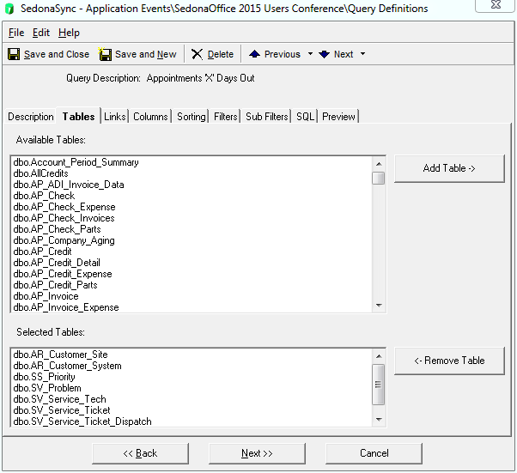
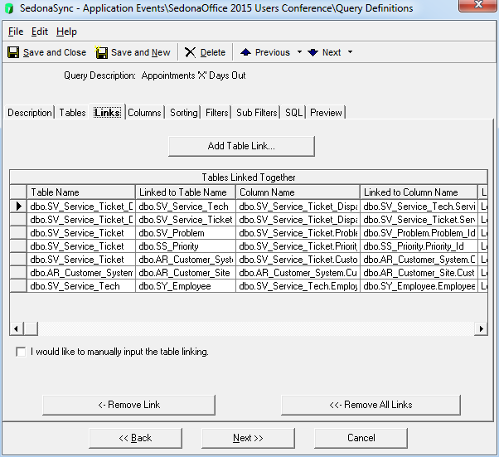
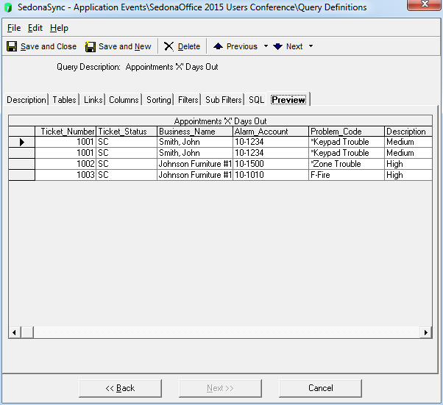
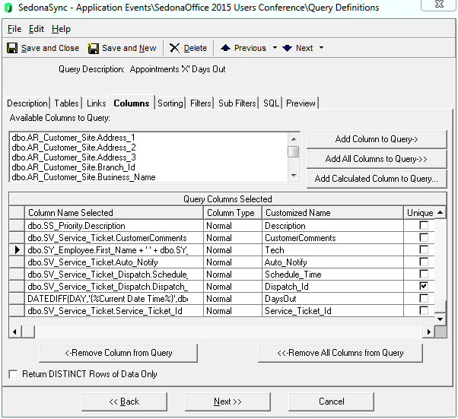
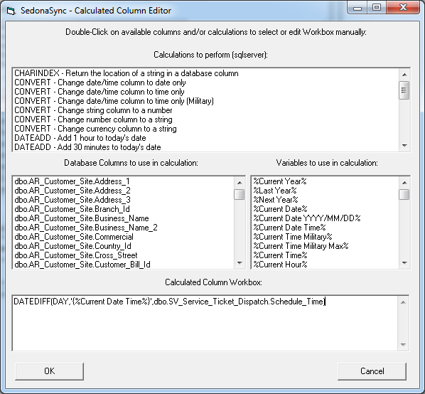
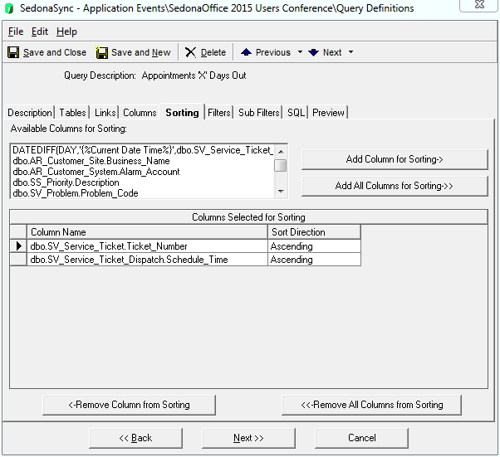
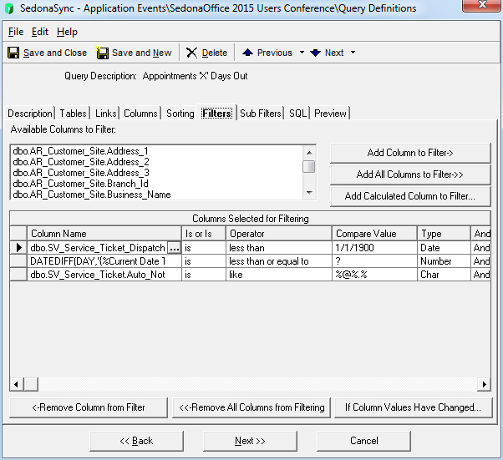
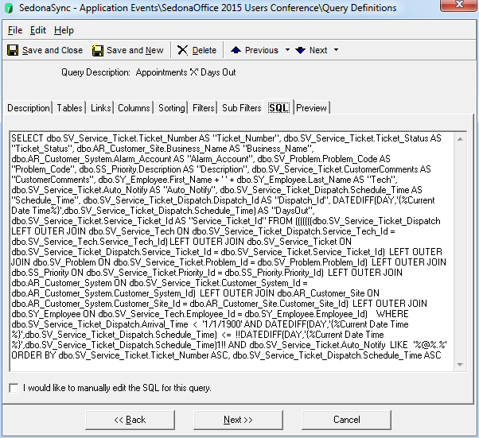
What is SedonaSync?

Slide 9
What is SedonaSync?
SedonaSync
Events
Emailed Alerts and Reports
Actions and Workflows
Using the collected data we can execute a workflow previously created in SQL such as a stored procedure, or run a query to Insert, Update, or Delete some data from a database. We can also run a custom VB script or run a program on the server...
We add and remove items from our email distribution queue. In addition, we record all actions taken and notify SedonaOffice of the notifications that have been sent in order to remove them from further processing.
Takes data collected from queries and if configured, generates the necessary reports and then emails the data to the end-user.

Slide 10
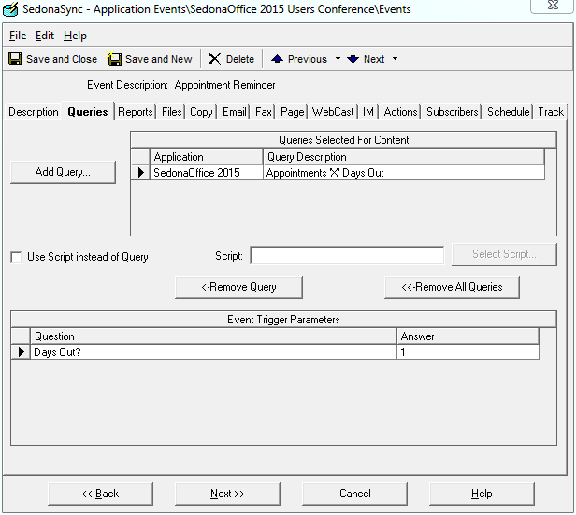
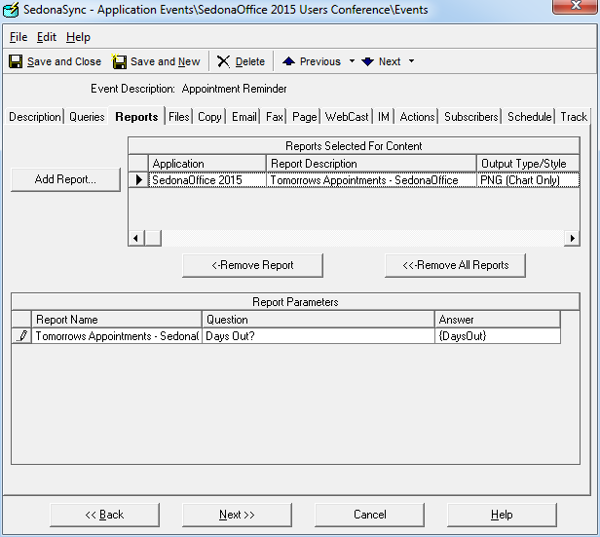
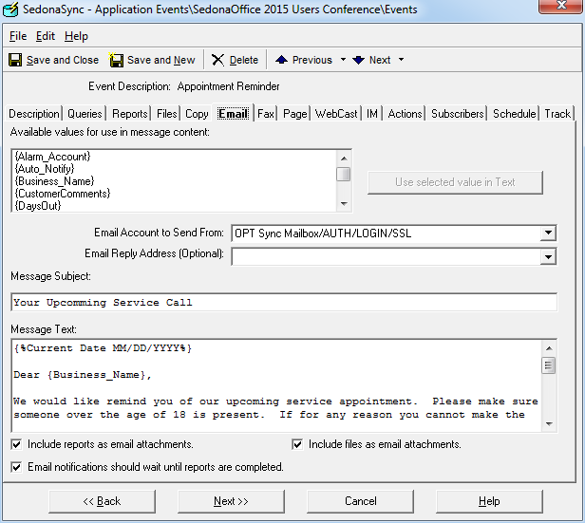
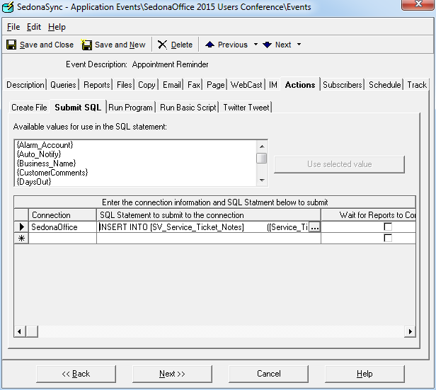
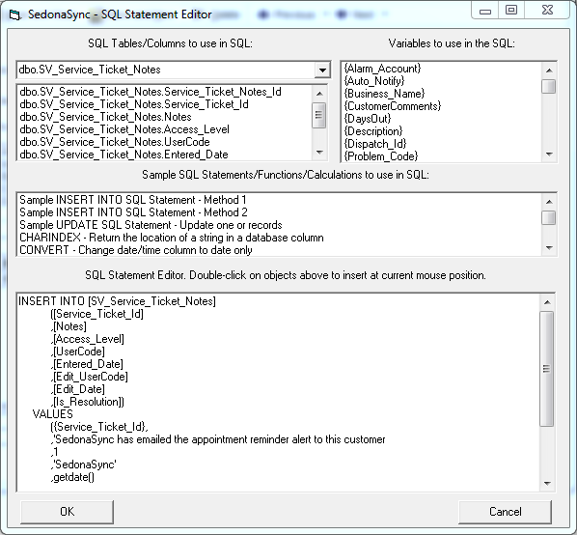
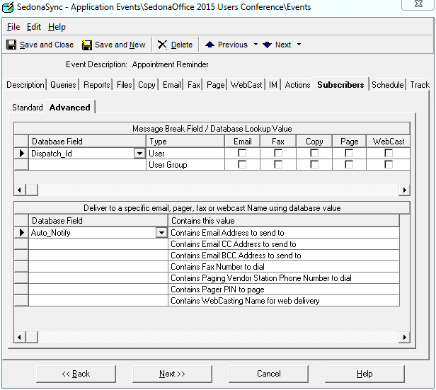
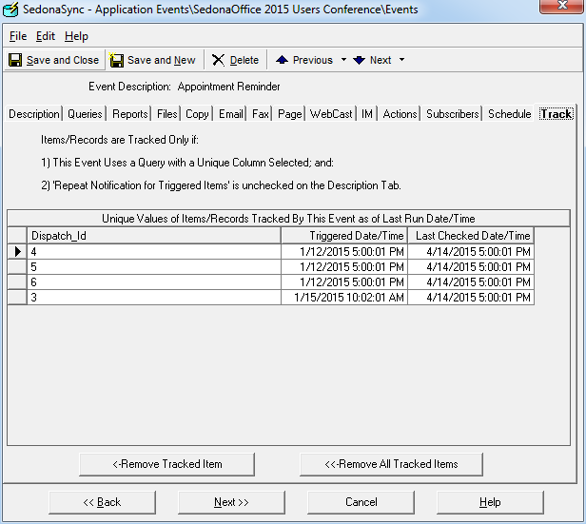
What is SedonaSync?

Slide 11
OPT Email Invocing

Slide 12
Email Invoice Options
Via SedonaOffice as HTML
Via OPT and SedonaSync as PDF
SedonaEmail Invoice Notification
SedonaOffice does contain as internal email process for emailing invoicing now as of v6.0 however these formats are not customizable and are in HTML code and not the standard PDF document.
SedonaSync Invoice Notification
SedonaSync comes bundled with a limited Sync event that can notify your customers when an invoice is created however this format is also in HTML and does not document in SedonaOffice that the invoice was sent.
OPT Email Invoicing in PDF.
OPT has created a robust invocing process around SedonaSync that allows the greatest level of flexibility. Our SedonaSync invoices formats are fully customizable and are attached to the email in the standard PDF format your customers are used to.
OPT Email Invoices in PDF via OPTWS
OPT also offers our invoice download method that allows your users to download their invoice directly from the invoice notification email, in PDF, and without having to sign into a portals. OPTWS will provide your customer with the most recent copy of the invoice in real time while tracking that the invoice has been downloaded.

Slide 13
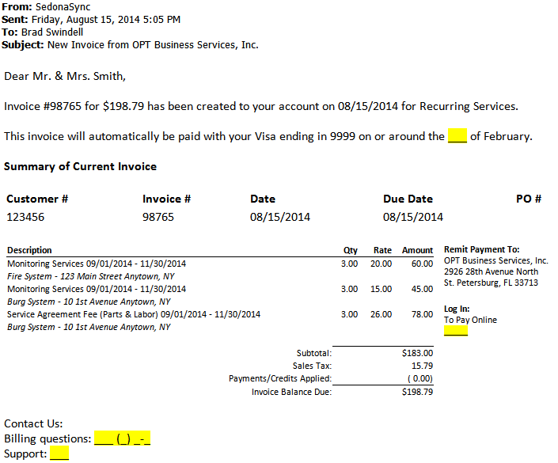
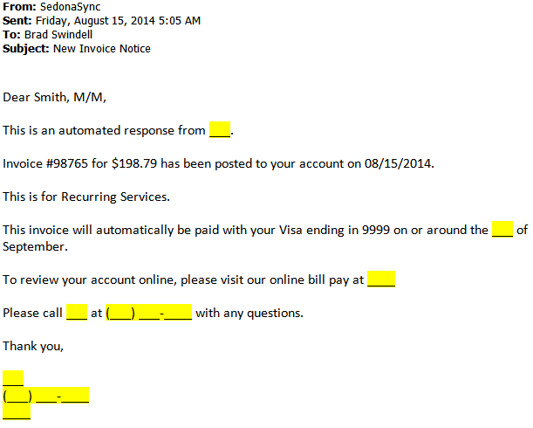
Email Invoice Options
SedonaOffice SedonaOffice
Invoice Notification Cycle Invoice Event

Slide 14
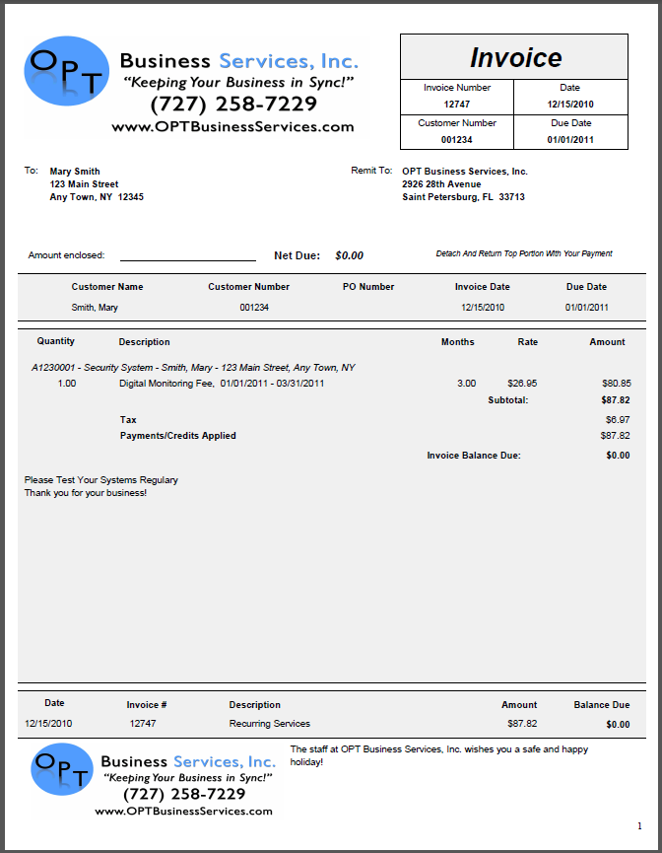
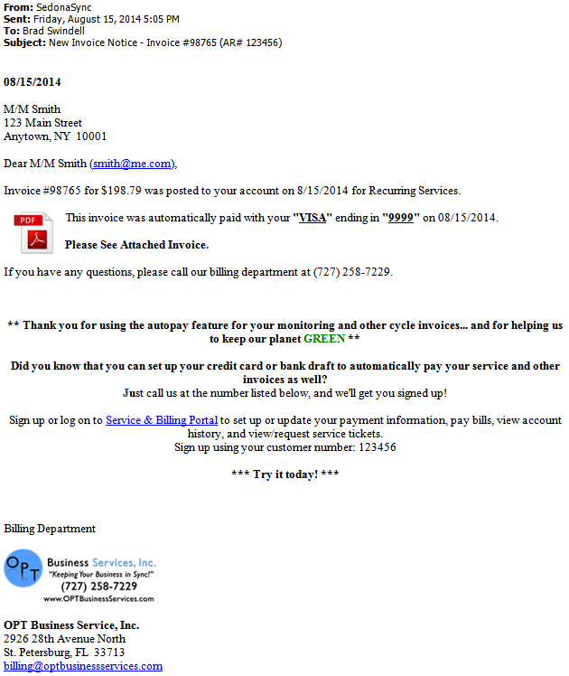
Email Invoice Options
OPT Email Invoice OPT Email PDF Invoice
as PDF Attachment Standard Format

Slide 15
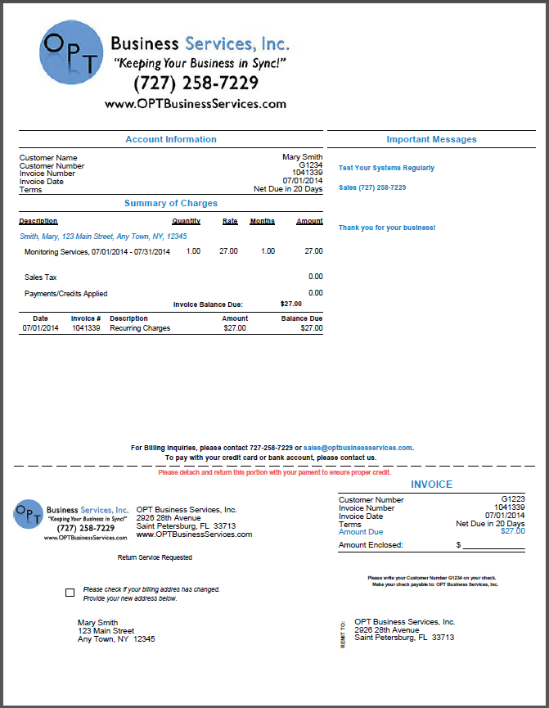
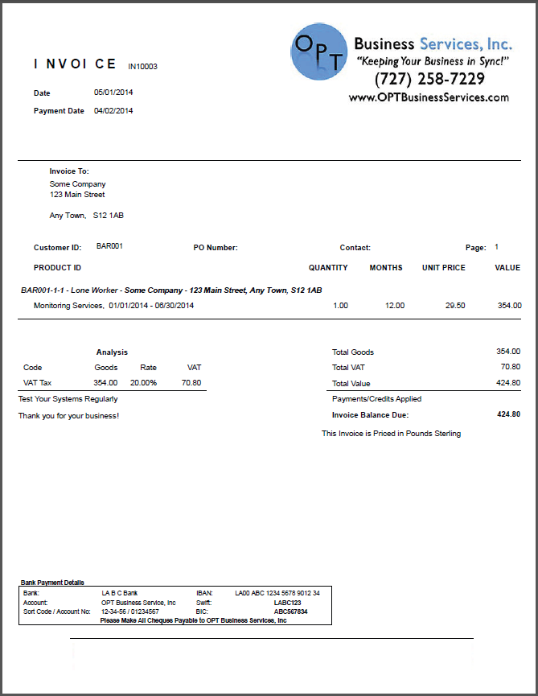
Email Invoice Options
OPT Email PDF Invoice OPT Email PDF Invoice
Bridgestone Format Euro Format

Slide 16
OPT Email Collections

Slide 17
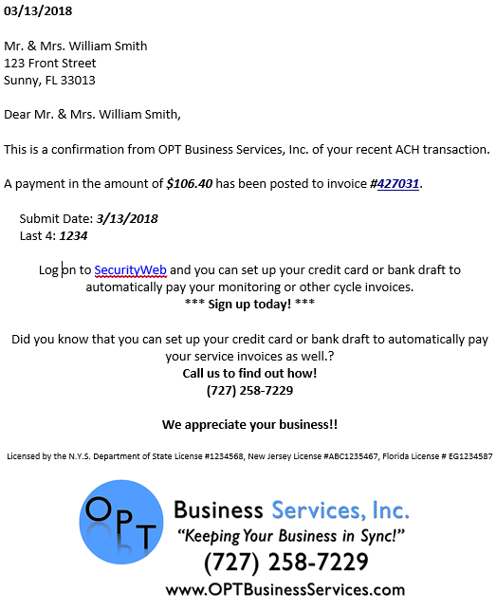
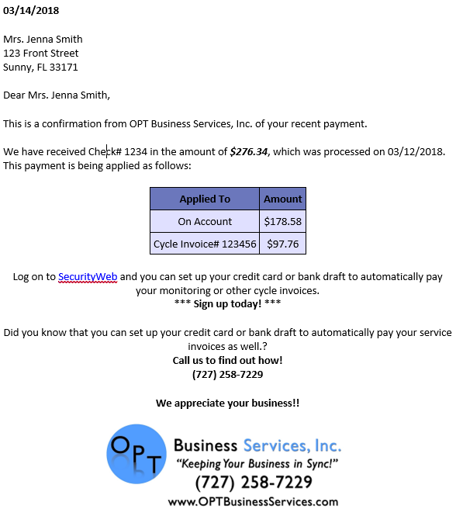
Payment Confirmation

Slide 18
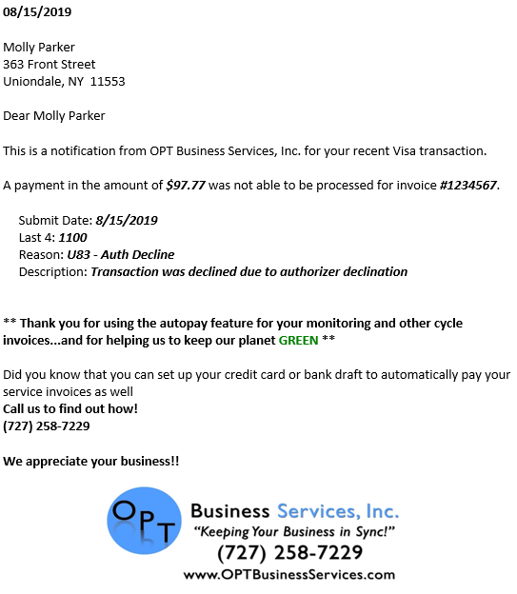
Payment Failed

Slide 19
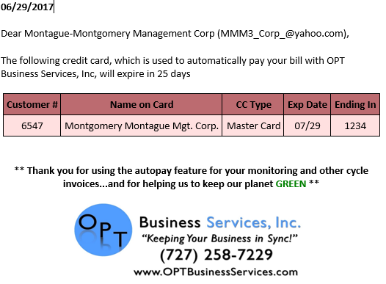
Credit Card Expiring

Slide 20
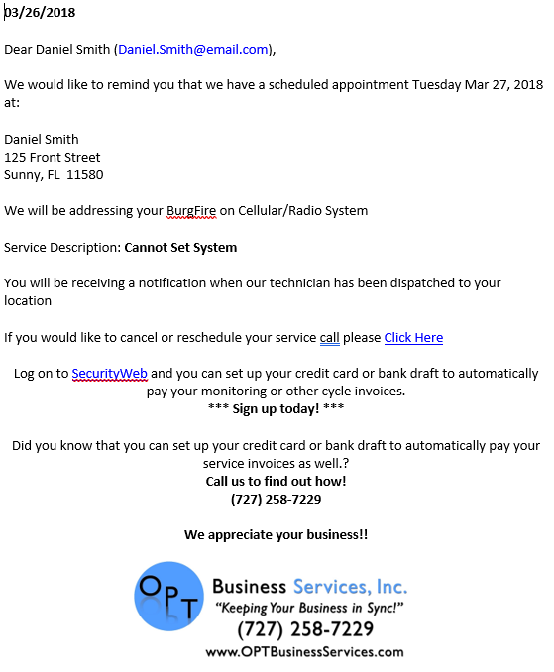
Appointment Reminder

Slide 21
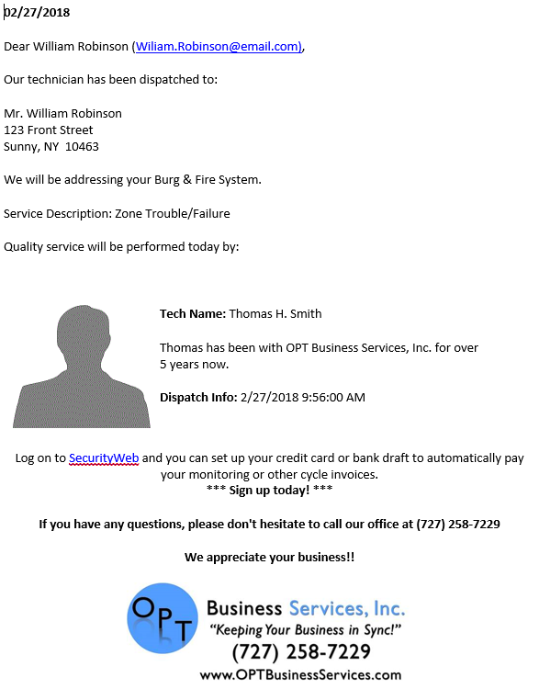
Dispatch Notification

Slide 22
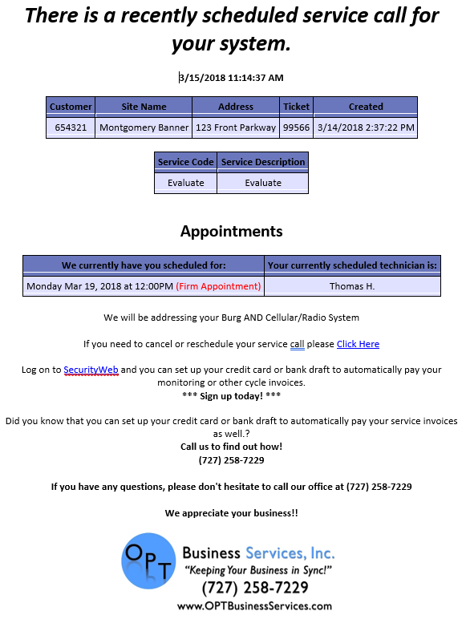
Ticket Scheduled

Slide 23
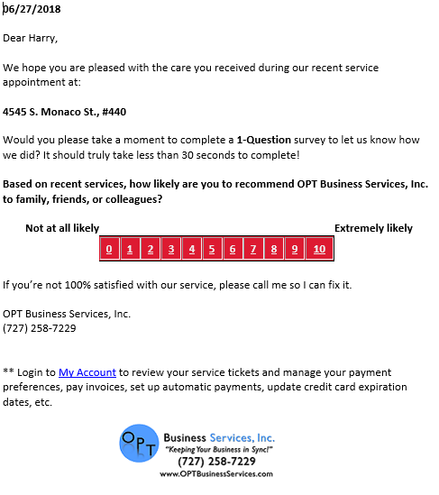
Ticket Survey

Slide 24
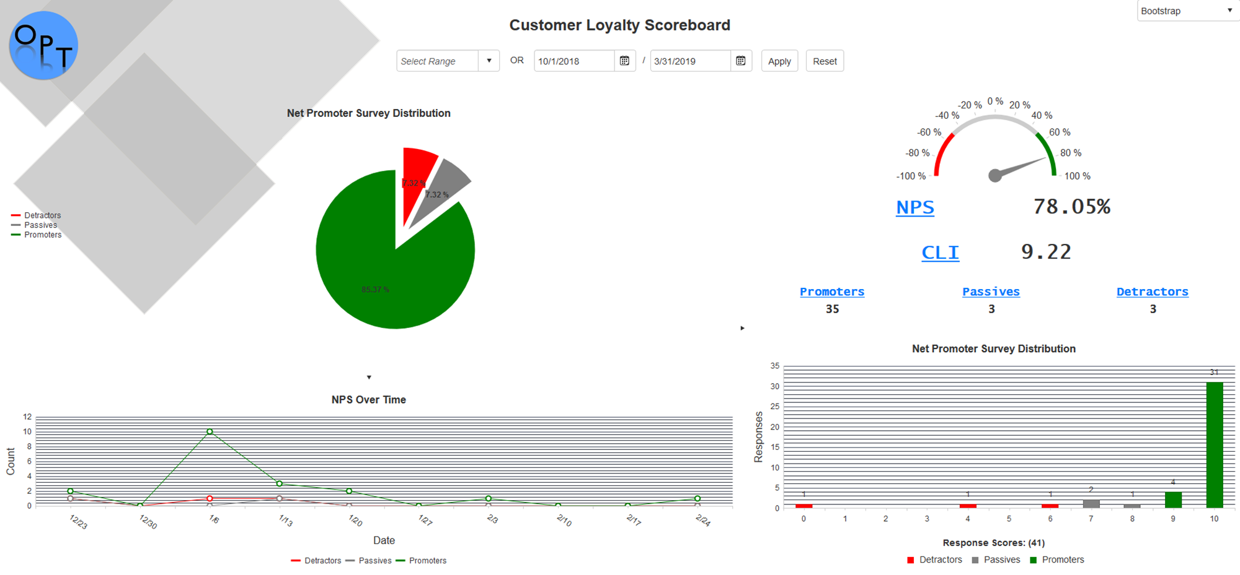
Company Dashboard

Slide 25
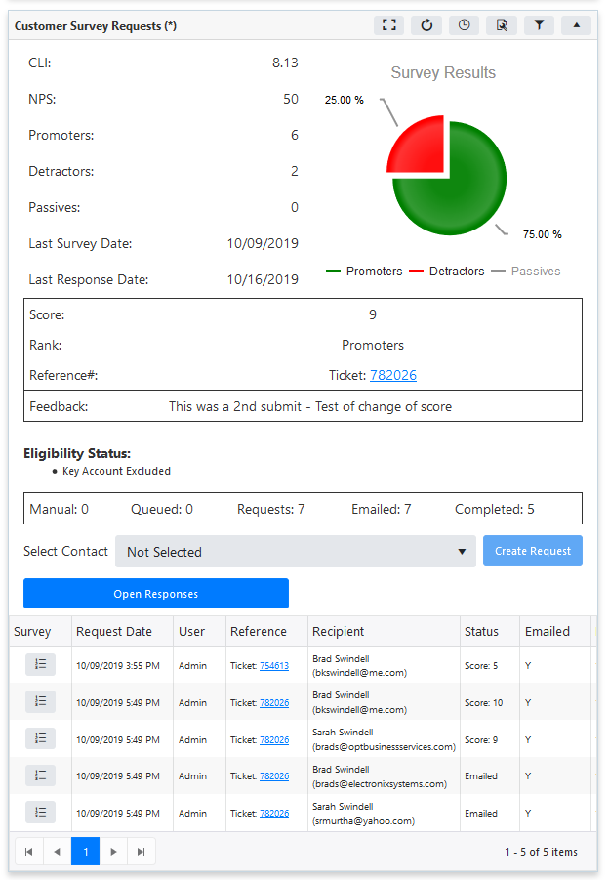
Customer Survey Analysis

Slide 26
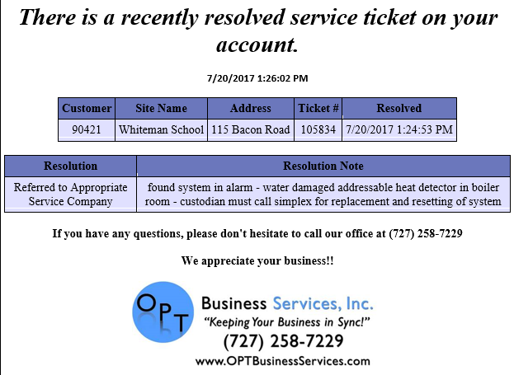
Ticket Resolved

Slide 27
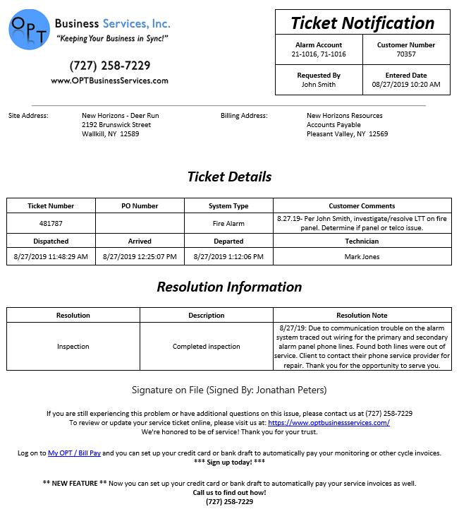
Ticket Resolution

Slide 28
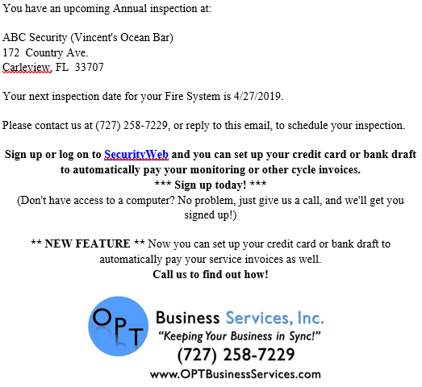
Inspection Reminder

Slide 29
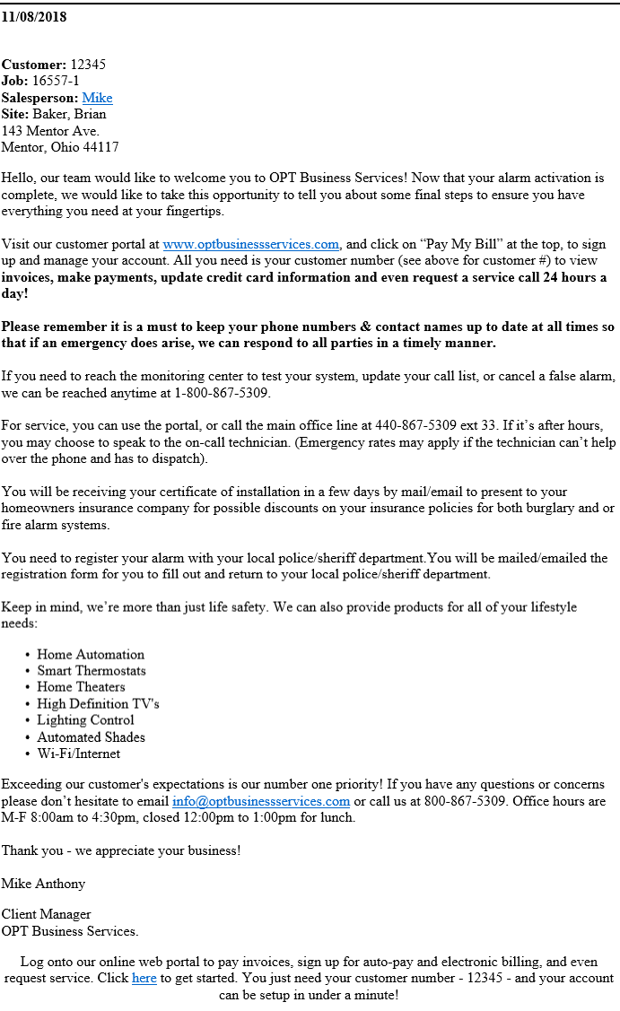
Notifications Based on Job Tasks

Slide 30
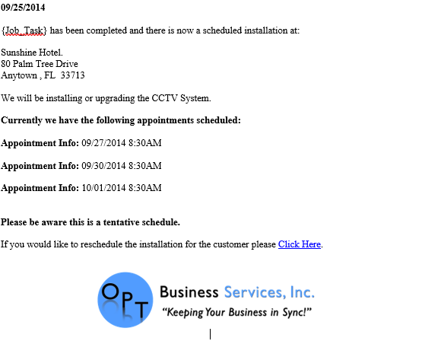
Custom Notifications

Slide 31
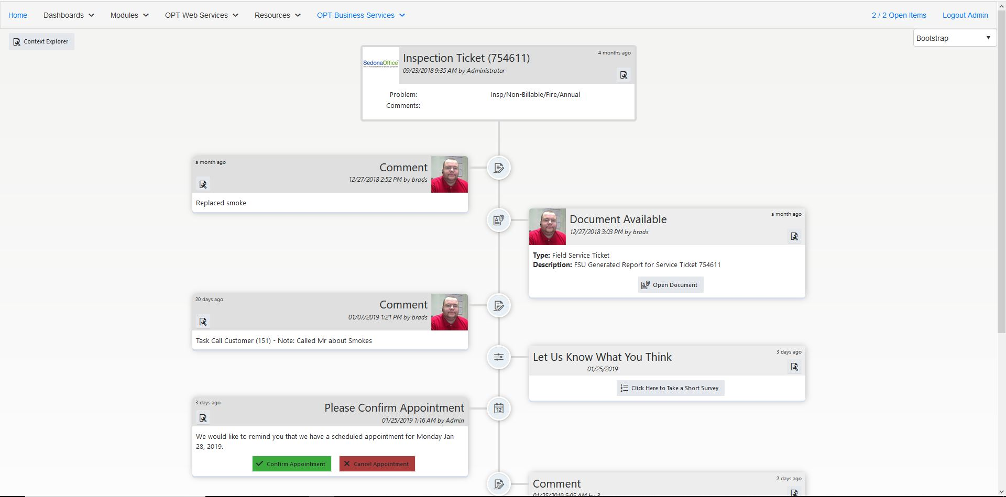
Timeline Preview

Slide 32
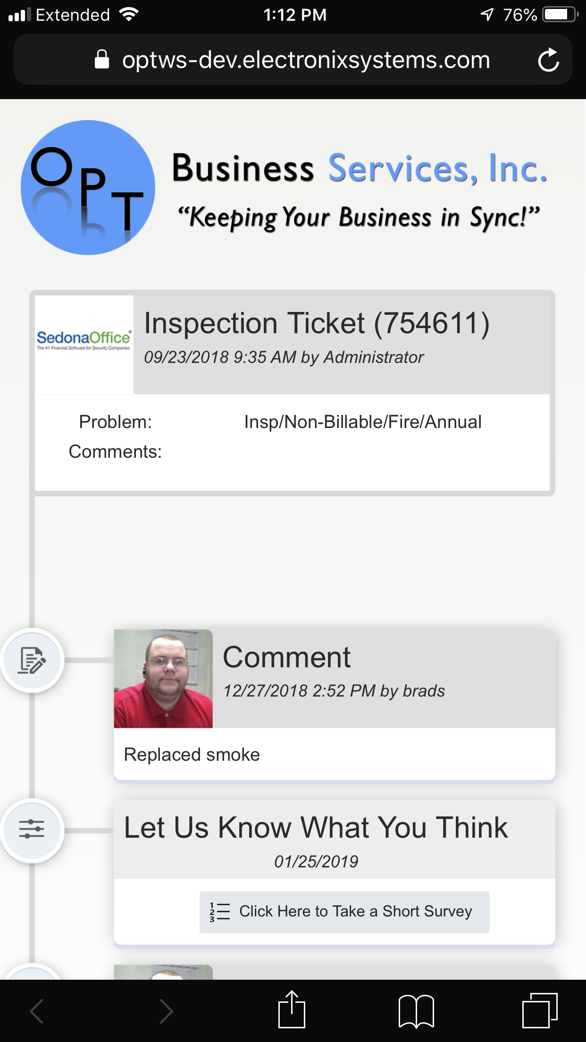
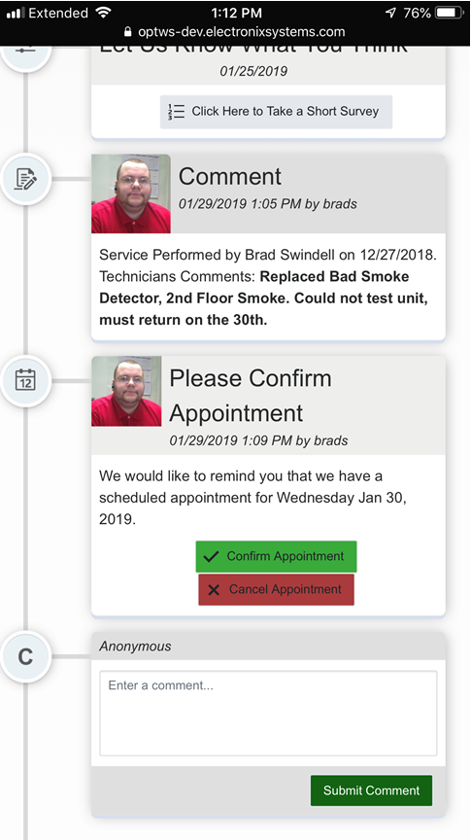
Timeline Items
Job / Ticket Created
Service Coordinator / Project Manger Details
Appointment Created
Appointment Scheduled
Confirm / Cancel Buttons
Job / Ticket Notes
Documents / Photos
Survey Request
Invoice
Pay Now via SedonaWeb
Add Comment
Custom Modules Available

Slide 33
Questions & Feedback

